Slide 1

Understanding how immigration realities intersect with IV-D obligations, access, and enforcement
MIGRANT FAMILIES’ PARTICIPATION IN IV-D SERVICES
Christina Mahoney
Deputy Attorney General, Child Support Enforcement Division
Illinois Attorney General’s Office

Slide 2

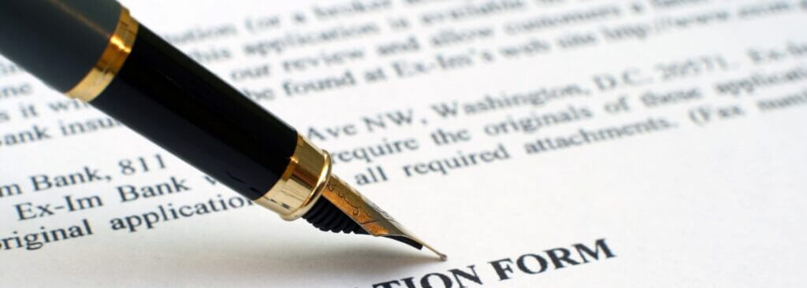
OBJECTIVES
Historical developments shaping immigration law and policy
Current challenges and service barriers in Illinois
IV-D eligibility and status-neutral access under federal and state law
“Parent Deported – Then What?”
Cross-State Collaboration

Slide 3

POLL:
Which issue do you encounter most often in your cases?
Missed court appearances
Difficulty locating parties
Inconsistent employment
Communication barriers
Case inactivity

Slide 4

U.S. IMMIGRATION TIMELINE: Federal Shifts
1790 Naturalization Act – citizenship limited to “free white persons.”
1882 Chinese Exclusion Act – first race-based exclusion.
1924 Immigration Act (Johnson-Reed) – quota system favoring Northern Europe.
1965 Hart-Celler Act – ended quotas; foundation of modern system.
1996 IIRIRA & PRWORA – introduced enforcement and benefit restrictions
2002 Homeland Security Act – created DHS/ICE/CBP; merged INS

Slide 5
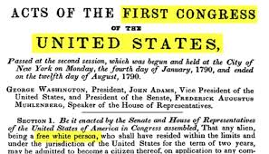
NATURALIZATION ACT OF 1790

Slide 6
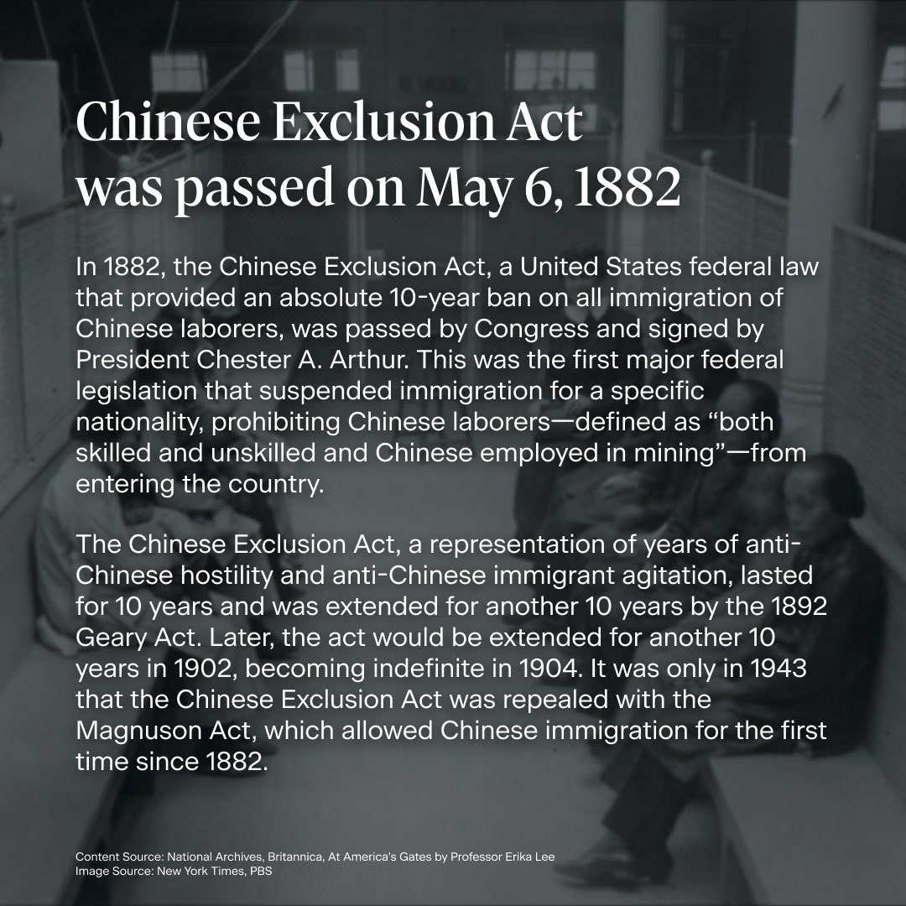
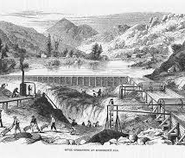
1882 CHINESE EXCLUSION ACT

Slide 7
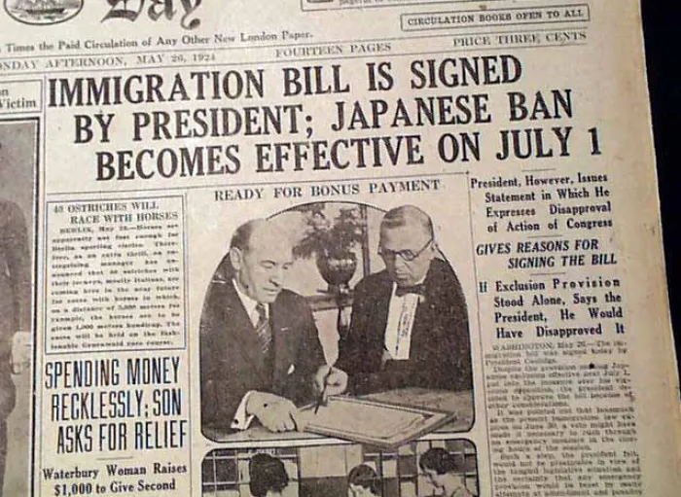
1924 IMMIGRATION ACT

Slide 8
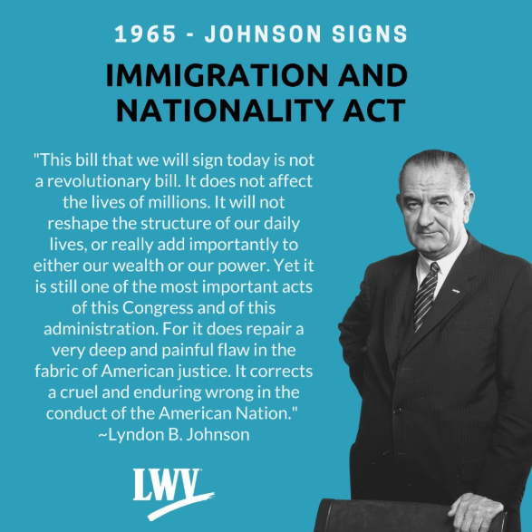
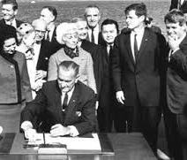
HART-CELLER IMMIGRATION AMENDMENTS ACT OF 1965

Slide 9
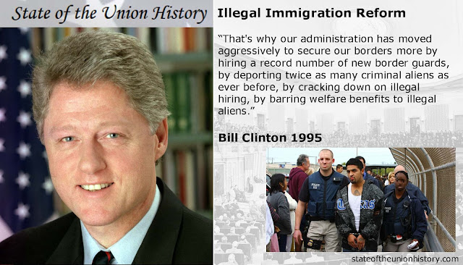
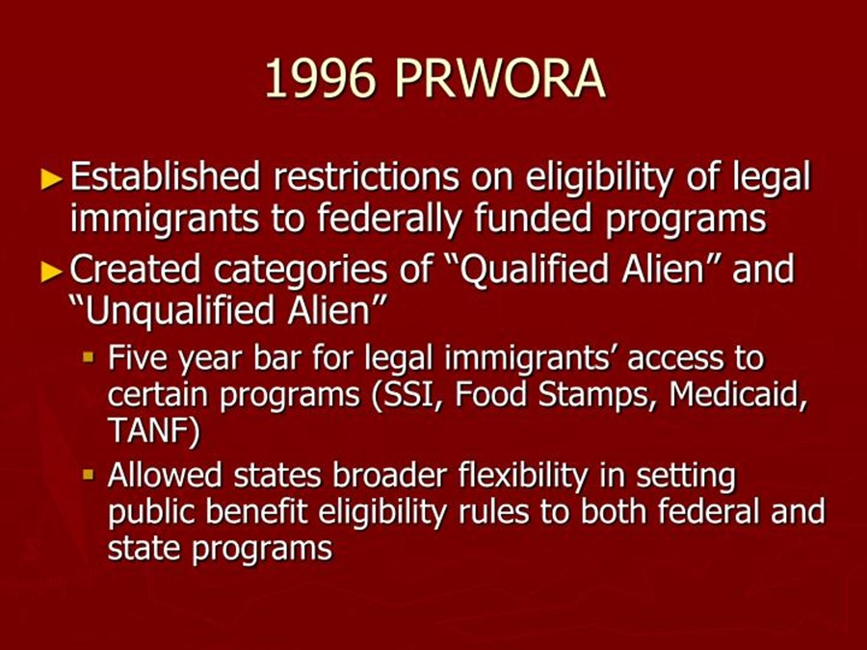
Illegal Immigration Reform and Immigrant Responsibility Act of 1996 (IIRIRA)
Personal Responsibility and Work Opportunity Reconciliation Act of 1996 (PRWORA)

Slide 10
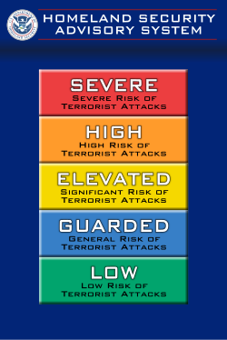
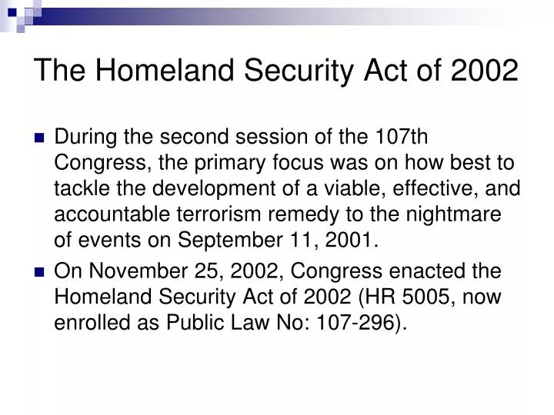
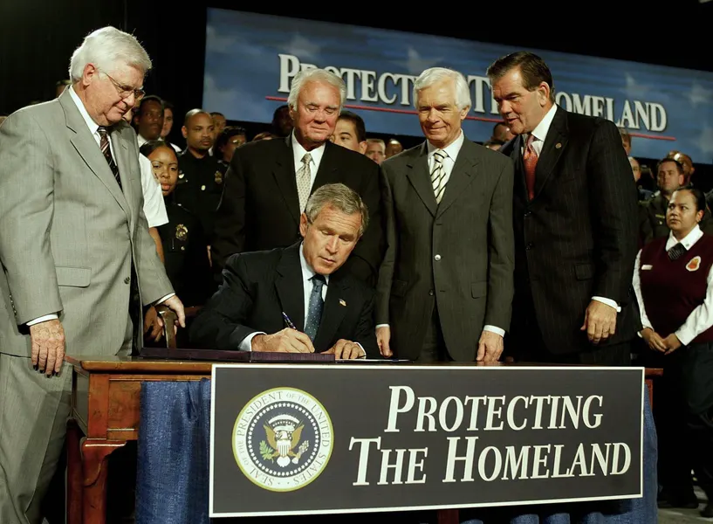
2002 HOMELAND SECURITY ACT

Slide 11
COURT & POLICY MILESTONES
Plyler v. Doe, 457 U.S. 202 (1982) – undocumented children entitled to education.
Arizona v. United States, 567 U.S. 387 (2012) – federal supremacy in immigration.
2012 DACA policy – prosecutorial discretion for undocumented immigrants brought here as children.
2017 Exec. Orders 13767/68 – border wall; border enforcement; sanctuary cities penalty.
2019-2022 – new rules on public charge inadmissibility; challenges to new rules; reversal of rule and implementation of pre-2019 definitions

Slide 12
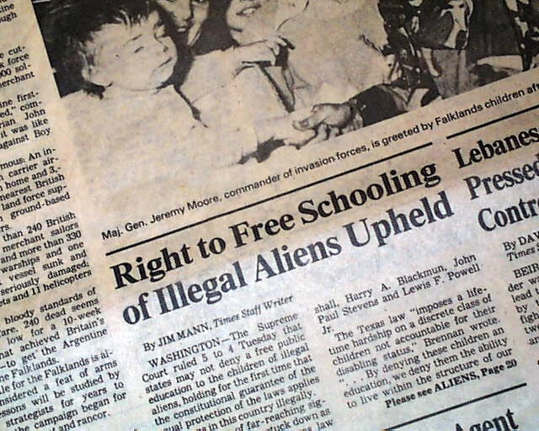

Plyler v. Doe 457 U.S. 202 (1982)

Slide 13
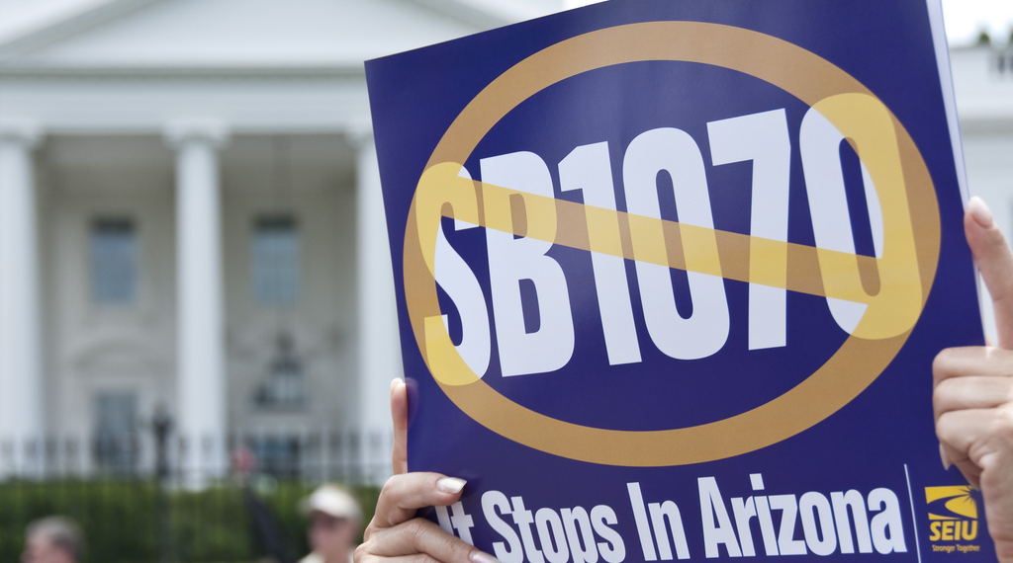
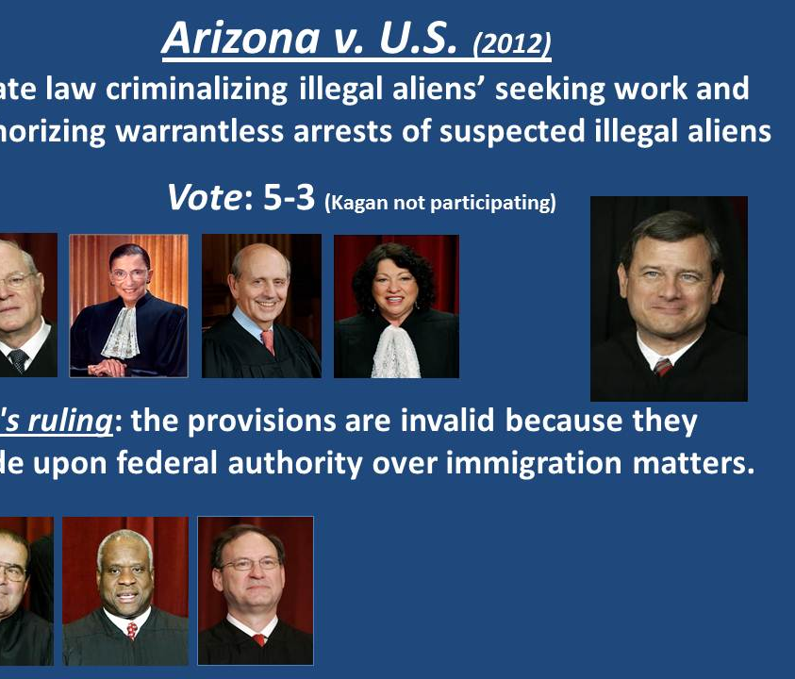
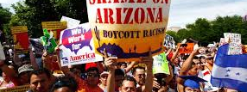
Arizona v. United States, 567 U.S. 387 (2012)

Slide 14
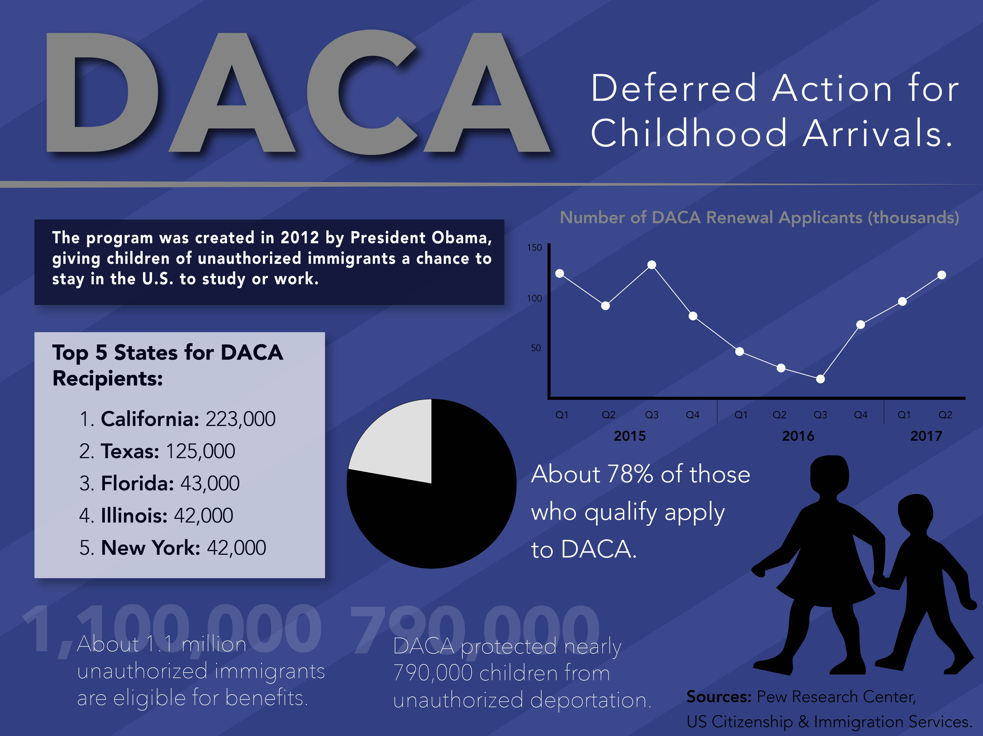
DACA – Deferred Action for Childhood Arrivals

Slide 15
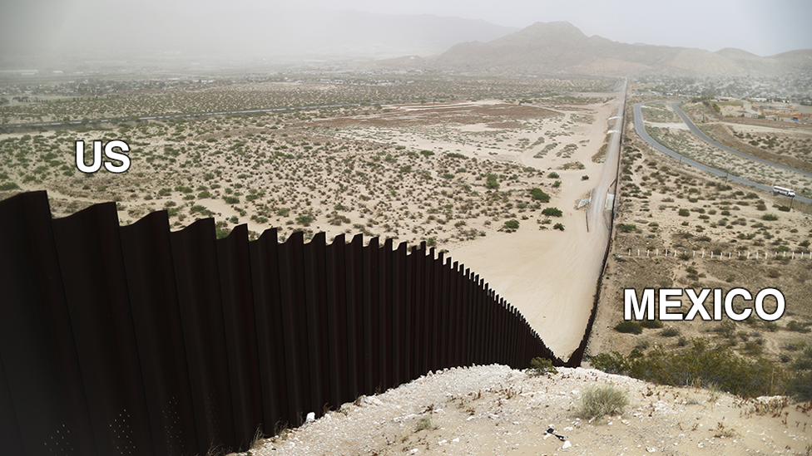

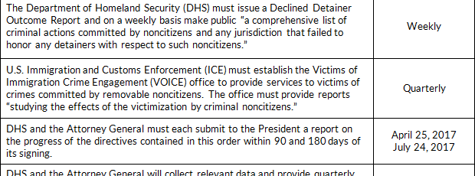
Executive Orders 13767 and 13768

Slide 16

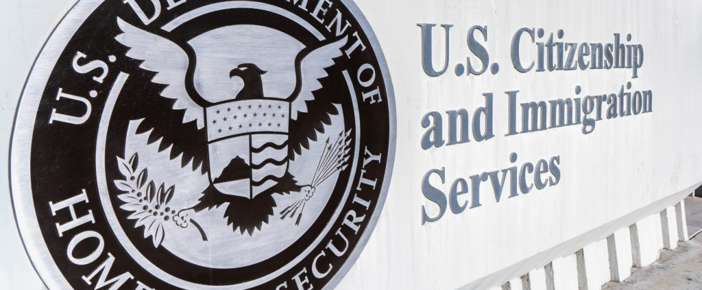
Dept. of Homeland Security (DHS) Final Rule on Public Charge (eff. Dec. 23, 2022)

Slide 17
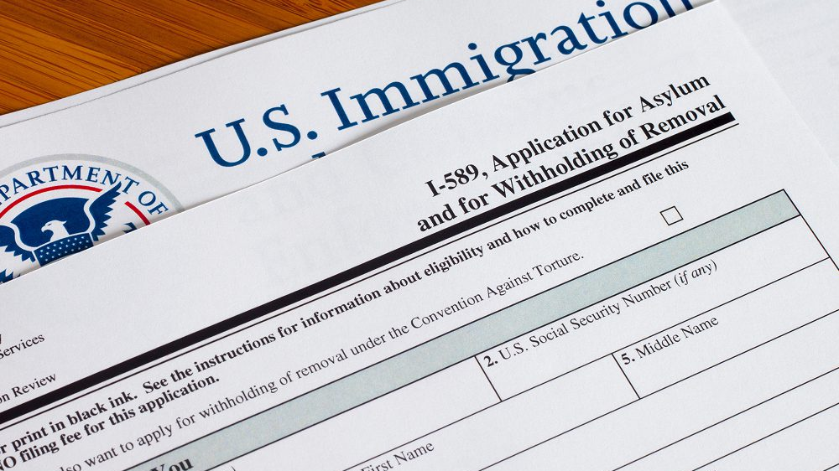
Public charge: The 2026 change
November 2025: DHS publishes NPRM
July 20: DHS publishes the final rule rescinding the 2022 regulations
August 18: USCIS issues replacement Policy Manual guidance
September 18: the rule and guidance take effect
91 Fed. Reg. 45324 (July 20, 2026); USCIS PA-2026-09 (Aug. 18, 2026)

Slide 18
Eligibility does not guarantee participation
Families may misunderstand which rules apply to them
A change affecting one household member can deter the entire family
Missed contact may reflect fear, language needs, or a practical barrier
Clear explanations and reliable follow-through support engagement
HISTORICAL LEGACY → MODERN PARTICIPATION
Immigration policy – access to public systems tied to legal status
Enforcement priorities have shifted; uncertainty remains constant
Mixed-status families must navigate multiple legal systems
Perception of risk affects participation more than actual eligibility

Slide 19
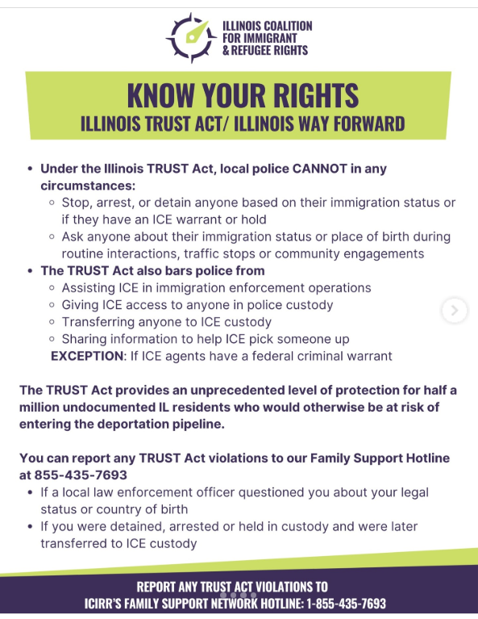


Way Forward Act/TRUST Act/Campaign for a Welcoming Illinois Act

Slide 20

MULTISTATE LITIGATION – ILLINOIS ATTORNEY GENERAL’S OFFICE
Key 2026 Immigration & Public Benefits Cases Involving Illinois AG
Public Charge Rule Challenge (September 2026):
Attorney General Raoul co-led a coalition of 22 states and the District of Columbia in suing the Department of Homeland Security (DHS) in the U.S. District Court for the Southern District of New York. The lawsuit works to block a rule allowing immigration officers broad discretion to deny green cards or entry to immigrants who lawfully use public benefits like Medicaid, SNAP (food stamps), and housing vouchers.
Access to Social Services / Welfare Reform Law Victory (September 2026):
Illinois was part of a multistate lawsuit that prevailed after a federal judge in Rhode Island struck down the administration's attempt to mandate that states cut off access by noncitizens to public aid programs, including emergency shelter, food, and violence prevention programs. The multistate coalition argued the administration unlawfully expanded the 1996 Personal Responsibility and Work Opportunity Reconciliation Act and violated the APA.
TANF Data and Funding Lawsuit (Earlier 2026):
Illinois was part of a multistate lawsuit that sued the administration over attempts by the Administration for Children and Families (ACF) to oversee state Temporary Assistance for Needy Families (TANF) programs and share private recipient data with the Department of Homeland Security to check immigration status. This included SSNs, addresses, and other sensitive personal data. In fact, the ACF already tried to illegally expand its authority this year when it froze TANF funds to five Democratic-led states, which was ultimately blocked by the courts.
SNAP Protections (January 2026 / Ongoing):
Illinois has joined in multiple legal actions filed since mid-2025 defending the Supplemental Nutrition Assistance Program (SNAP), protecting recipient data, and fighting guidance that threatened to strip benefits from lawfully residing immigrants.

Slide 21

Immigration & IV-D Caseloads: Why This Matters
In Illinois (2023-24):
~1.9 million foreign-born (≈15% of population), of which 98,800 are children
1,230,700 immigrant workers in Illinois’ labor force (18.5% of workforce)
922,400 U.S. born residents live with at least one immigrant parent
Top countries of origin: Mexico 33%, India 9%, Poland (6%), Philippines (5%), China (4%)
~48% naturalized citizens; ≈70% of children in immigrant families are U.S. citizens
Concentrations: Cook, DuPage, Kane, Lake, Will, Kendall, Champaign

Slide 22
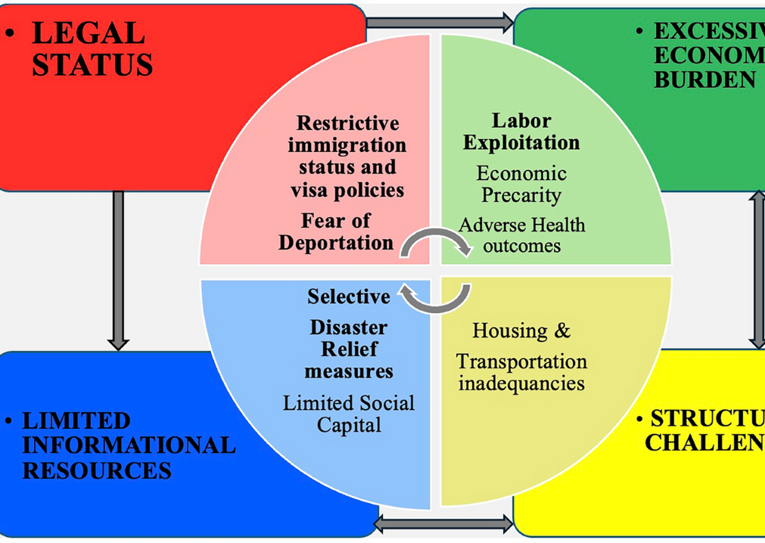
BARRIERS IN PRACTICE
Work authorization instability → income verification gaps
Regulatory uncertainty → decrease in IV-D participation
Dense administrative notices → comprehension challenges
Mobility across jurisdictions (interstate and international)
Informal or cash-based employment
Fear of unintended government consequences

Slide 23
PART II – IV-D ACCESS & MIGRANT PARTICIPATION

Slide 24

TITLE IV-D LEGAL FRAMEWORK: Status-Neutral Access
42 U.S.C. § 654(4)(A) → services must be available to “all individuals”
45 C.F.R. § 302.56 → guidelines for setting child support orders
OCSE AT-20-14 → consolidates interstate and intergovernmental policy
But Equal Access Clause of Title VI of Civil Rights Act amended March 2025 (42 U.S.C. § 2000d) → language access obligation discretionary; English official language of the United States; recission of LEP guidance

Slide 25

POLL
What is your biggest challenge when a parent relocates?
Locating the parent
Verifying income
Serving documents
Enforcing support
Maintaining contact

Slide 26
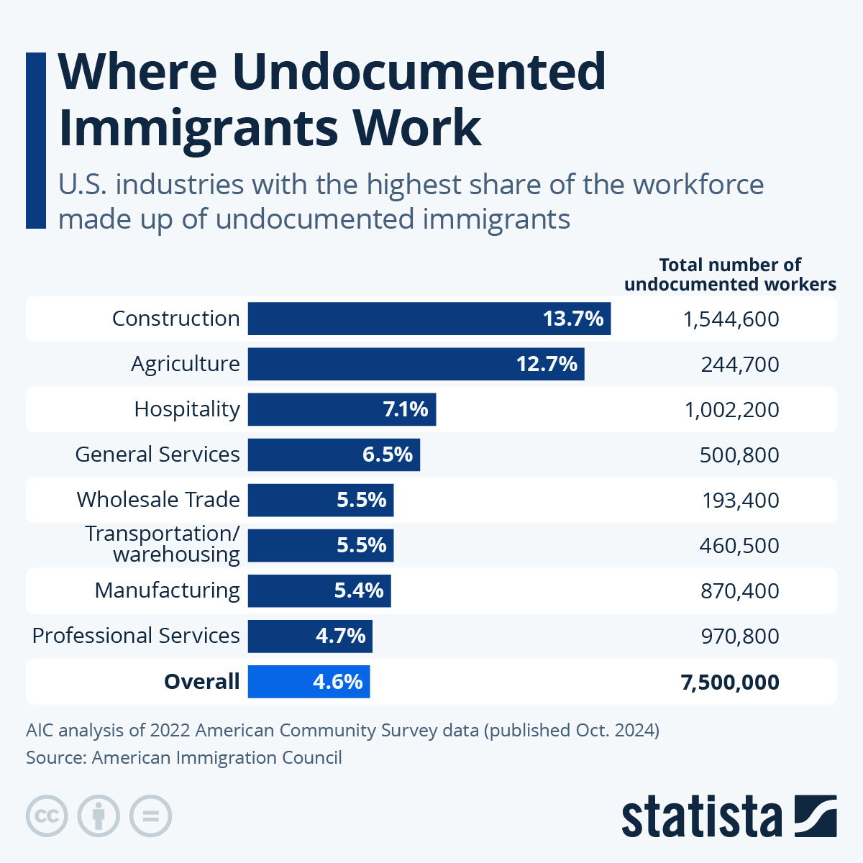
Challenges include:
  Lack of SSN records
  Informal employment
  Reluctance to interact with government systems
  Mobility between communities
Locate tips:
  Rely on community connections
  (churches, markets, neighborhoods)
  Track common work locations
  Track seasonal employment patterns
  Maintain contact with family members or relatives
  New hire reporting to check for formal employment

Slide 27
PARENT DEPORTED – THEN WHAT?

Slide 28
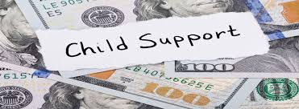
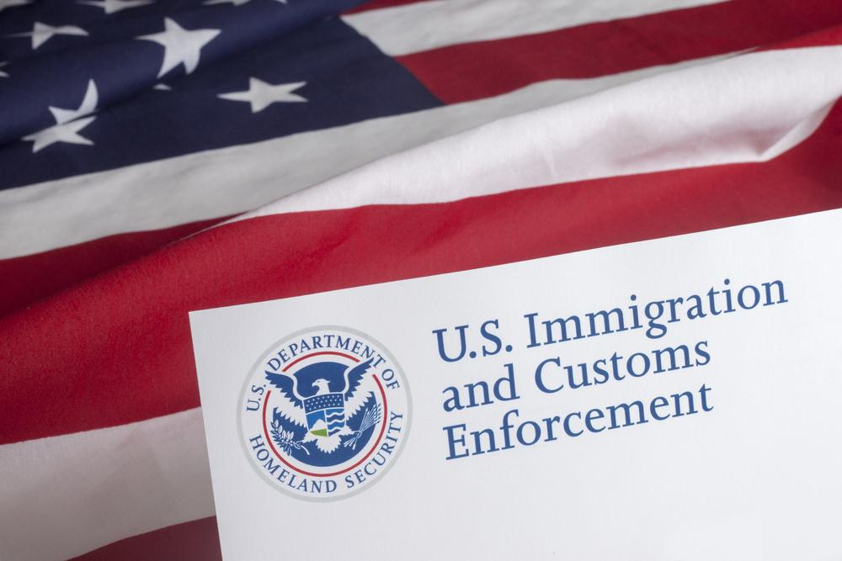
THE PARENT WHO VANISHES OVERNIGHT
A parent with an active support order:
  Stops appearing at work
  Stops responding to communication
  Payments stop immediately
Employer reports the parent was taken into immigration custody

Slide 29
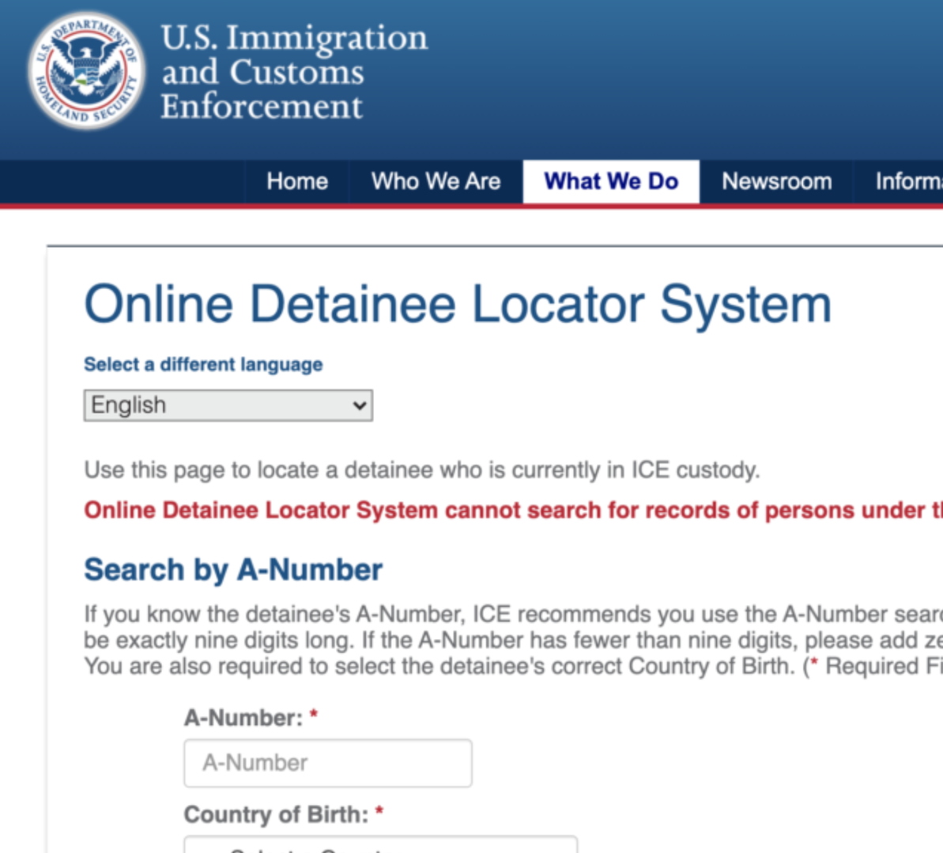
ICE DETENTION LOCATE
ICE Detainee Locator
Search by:
  Alien registration number, or
  Name + DOB + country of birth
https://locator.ice.gov/odls/#/search

Slide 30
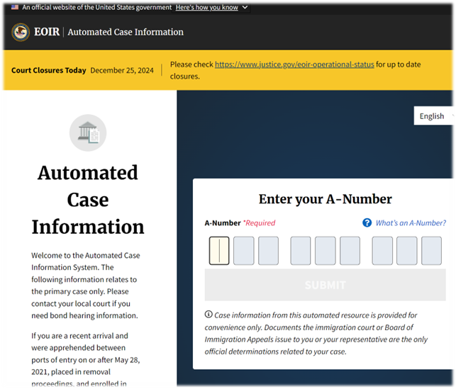
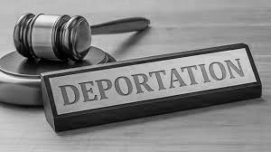
THE DEPORTATION CASE
A parent is removed from the United States.
The support order remains active.
The custodial parents asks: “Can we still enforce the order?”
The issue = Locate
Family members
Custodial Parent
Immigration Proceedings Search: https://portal.ice.gov/eoir
A-Number (9 digits)
First/last name (must match exactly)
Country of birth

Slide 31



AFTER DEPORTATION
Possible pathways once parent is located:
  UIFSA international cases
  Hague Convention enforcement
  Central authority cooperation
  Foreign court proceedings

Slide 32

HOW THE SYSTEM RESPONDS
Removal does not terminate support obligation
Enforcement and modification proceed under issuing state law
UIFSA/Hague Convention/FRC – jurisdiction and enforcement abroad

Slide 33

INTERGOVERNMENTAL AND INTERNATIONAL ENFORCEMENT
UIFSA (750 ILCS 22/) → interstate & international cases
OCSE AT-20-14 → intergovernmental case processing
Hague Convention on Child Support (2017) → mutual recognition with 50+ nations
Foreign Reciprocating Countries (FRCs) – OCSE approved list (e.g., Canada, UK, Australia) – 42 U.S.C. § 659a
Comity → judicial discretion for non-treaty nations

Slide 34

Enforcement Options
Step Status Enforcement Path Authority
A Parent still in U.S. Standard IV-D tools 45 CFR § 303.6
B Deported to Hague country Transmit via OCSS Central Authority Hague Art. 6
C Deported to FRC (non-Hague) Use bilateral agreement 42 USC § 659a
D Non-FRC country Seek comity recognition or U.S. UIFSA §§ 104, 210, state law
asset seizure
E Unknown location OCSS ➡️ FPLS

Slide 35
Field Scenarios:
NCP is deported to Mexico and CP and child remain in Illinois. IV-D case is opened, but no contact from NCP. CP requests modification.
NCP moves from Illinois to Texas. There is an active IV-D case in Illinois and NCP is employed. CP reports missed payments.
NCP returns to home country of El Salvador (Hague Country as of 2/7/26) and applies for IV-D services through the Central Authority.
NCP relocates outside the United States. There is no verified income, but CP requests enforcement.
CP misses an intake appointment because they are hesitant to proceed and concerned about sharing information to case workers.

Slide 36

Documentation and Communication
  Use Parent Locator Services (FPLS 45 C.F.R. 303.70)
  Request foreign address via family or consulate
  Translate order and serve per UIFSA § 602
  Maintain records in state system and notes

Slide 37

CAREGIVER AND CHILD SUPPORT
Refer CP to resources for immigration planning
Explain order continuity and possible modification
Coordinate or Offer resources – ex. Indianapolis Immigrant Legal Services Fund, Catholic Charities

Slide 38

KEY TAKEAWAYS
IV-D services are available without regard to immigration status under federal law.
Confidentiality laws preclude information sharing to outside agencies.
Orders remain valid after deportation; enforce or modify promptly.
Partnerships and language access increase compliance and trust.

Slide 39

Illinois and State Resources
Illinois Department of Healthcare and Family Services (HFS), Division of Child Support Services
HFS Form CSE-1: Application for Child Support Services (English & Spanish)
HFS Policy Manual, Child Support Section — Procedures for interstate and international cases
Contact: Division of Child Support Services Policy Unit (Springfield Office)
Illinois DHS Welcoming Centers
State-funded one-stop assistance for immigrants and refugees
Provides interpreter services, case management, housing and legal referrals
Illinois Coalition for Immigrant and Refugee Rights (ICIRR)
Community-based partner for outreach and family education on safe access to public programs
Illinois Collaboration on Domestic Violence and Immigration (ICDI)
Resource library for service providers working with immigrant families, including language access, public-benefit, and safety planning tools
Illinois Immigration Information HUB – www.iilinoisimmigrationinfo.org
Illinois Legal Aid Online (ILAO)
“After a Removal Order” guide — custody, guardianship, and child-support information for families affected by deportation
Illinois TRUST Act (5 ILCS 805/10)
State statute prohibiting disclosure of personal information to immigration authorities without a judicial warrant
Public Act 102-0234 – Way Forward Act (2021)
Expands the TRUST Act; prohibits state agencies and local governments from participating in civil immigration enforcement agreements
Federal & National IV-D Resources
U.S. Department of Health and Human Services, Office of Child Support Services (OCSS)
AT-20-14: Interstate Child Support Policy (2020) — replaces prior policy memoranda
AT-17-02: International Case Processing Under UIFSA 2008 and the Hague Convention
PIQ-00-02 (rescinded) — replaced by AT-20-14
OCSS International Resources Portal: https://www.acf.hhs.gov/css/international
U.S. Office of Child Support Enforcement (OCSE) Central Authority Directory
Contact list of U.S. and foreign Central Authorities for Hague Convention child-support cases
UIFSA (2008) – Uniform Interstate Family Support Act
Illinois codification: 750 ILCS 22/
Governs interstate and international child-support enforcement, modification, and registration
Federal Regulations
45 C.F.R. § 303.6 – Enforcement procedures
45 C.F.R. § 303.7 – Intergovernmental cooperation
45 C.F.R. § 303.8 – Review and adjustment (modification)
45 C.F.R. § 303.21 – Safeguarding case information
45 C.F.R. § 303.70 – Federal Parent Locator Service (FPLS)
Hague Child Support Convention (2007)
Convention on the International Recovery of Child Support and Other Forms of Family Maintenance
Entered into force for the U.S. on January 1, 2017
Administered domestically by OCSS
Data & Research Resources
City of Chicago Migrant Response Dashboard (2025) – DFSS / Office of Emergency Management
U.S. Citizenship and Immigration Services (USCIS) – I-765 Processing Time Data
American Immigration Council (2024) – Immigrants in Illinois: Fact Sheet
Pew Research Center (2023) – U.S. Immigration Trends
Migration Policy Institute (MPI) – State Immigration Data Profiles: Illinois
Illinois Attorney General, Trump Administration Litigation Since Jan. 20, 2025, accessible at: FINAL first year litigation list as of 1.15.26.pdf

