Slide 1
2026
Recent federal and Illinois decisions affecting child support practice
CASE LAW
UPDATE
Establishment • Modification • UIFSA • Administrative Orders • Enforcement
Selected 2025–2026 decisions
IFSEA
Notes:
Opening: This is a selective update focused on cases with a practical child-support or jurisdictional point. Two cases—Ramsey and Dalrymple—are Rule 23 orders and are included for their reasoning and fact patterns, not as precedential authority.

Slide 2
U.S. SUPREME COURT
T.M. v. University of Maryland Medical System Corp.
608 U.S. 668 (2026) • decided June 18, 2026
The question
The holding
Why lawyers care
Does Rooker-Feldman apply when the state-court judgment is still subject to state appellate review?
Yes. Federal district courts lack jurisdiction over suits that ask them to review and reject a state-court judgment—even if state appellate review is still available. The relevant question is whether the federal plaintiff is “complaining of injuries caused by, and is seeking relief from, the state-court judgment itself.”
This case resolved a longstanding circuit split and abrogated six circuit court decisions that had required state-court proceedings to have “ended” before Rooker-Feldman could apply. A dissatisfied litigant cannot treat federal district court as an alternative appellate route from a state support judgment.
TAKEAWAY
State-court loser → state appellate process, not federal district court.
Notes:
T.M. involved a federal challenge to a state-court consent order while a state appeal remained possible. The Supreme Court held Rooker-Feldman still applies. Keep the point narrow: it addresses federal district-court jurisdiction over attacks on state judgments; it does not convert every related federal claim into a jurisdictional bar. Source: T.M. v. Univ. of Md. Med. Sys. Corp., No. 25-197 (U.S. June 18, 2026).

Slide 3
PUBLISHED
In re Parentage of A.L.G.
2026 IL App (3d) 250124 • retroactive child support
Which date controls?
Jan. 2020
Mar. 2020
Jan. 2021
Parentage petition filed
Counter-petition served
Trial court retro date
No support requested
Support requested
Too late
§ 802(a): support commences with service of summons on the pleading seeking support – no earlier, and no later.
TAKEAWAY
Identify the pleading that actually requests support—and its service date. The rule is activated only by service of a petition seeking relief under the Parentage Act, and not by any other filing.
Notes:
A.L.G. had many issues; for this update, isolate the retroactivity point. The Third District reversed the retroactive-support date and directed an award beginning March 10, 2020, the service date for the counter-petition seeking support.

Slide 4
PUBLISHED
Tucker v. Department of Healthcare & Family Services
2026 IL App (1st) 251061 • administrative paternity/support orders
2007
2015
2023
2026
Default paternity + support order
Tucker seeks modification
Attack on 2007 orders
First District affirms
Substitute service at mother’s address
Current support reduced to $0
Claims original service was defective
Administrative challenge too late
Majority
Special concurrence
HFS lacked authority to entertain the untimely administrative challenge; Tucker unquestionably knew of the orders by 2015.
An agency’s statutory limits do not erase a potentially valid voidness claim; the question becomes where that claim can be heard.
TAKEAWAY
The two-year administrative limit is real. A different forum may be required for a true voidness claim – as long as you plead the remedy a circuit court may grant relief upon.
Notes:
Tucker is the procedural centerpiece. The majority affirmed because the Department lacked jurisdiction over the administrative appeal. Justice Martin’s concurrence focused on the difference between a court’s inherent power over void judgments and an agency’s statutory authority. That sets up Stone Street.

Slide 5
TUCKER COMPANION
Stone Street Partners: the missing remedy
2014 IL App (1st) 123654 • the case Tucker cites
But the appellate court found the voidness-based claim should proceed because Stone Street had included a claim for declaratory relief, and by doing so, the circuit court could address voidness through a claim for declaratory judgment.
Agency problem
Administrative review
Circuit-court relief
Allegedly defective notice
Years later, Stone Street asks the agency to vacate the old order
Agency says: no statutory authority to do it
Dismissal affirmed because the agency itself lacked jurisdiction to reopen the old judgment.
TAKEAWAY
Tucker + Stone Street: agency limits may close one door without eliminating the underlying judicial remedy. If you are attacking an old admin order as void, plead the remedy that the court can actually hear.
Notes:
Stone Street was not a child-support case, but Tucker cites it for the procedural dilemma. The key distinction is between administrative review of an agency decision the agency had no power to make and an independent circuit-court avenue addressing alleged voidness/equitable relief.

Slide 6
PUBLISHED
In re Marriage of Patel
2025 IL App (3d) 240453 • guideline deviation + modification
The deal
What changed
Third District
Father: ~$250K income at divorce.
MSA required additional support up to $500K of income—but purported to exclude income above $500K forever and make the cap nonmodifiable.
Father’s income later rose to at least ~$1.38M/year.
Mother challenged the cap and sought modification; trial court increased support to $3,750/month.
The income cap was a deviation requiring statutory findings. And the parties could not contract away the court’s continuing authority to modify support after a substantial change.
TAKEAWAY
Parties can agree to a deviation. They cannot privatize child support or make the court’s statutory authority disappear.
Notes:
The memorable phrase here is “you cannot privatize child support.” Emphasize both parts: required written findings for a deviation, and the inability of an MSA to strip the court of future modification authority.

Slide 7
UIFSA - 750 ILCS 22/205(a)(2)
What counts as “consent” when everyone has left the issuing state?
Jade J. + Cox
Illinois appellate courts look closely at what the parties did in the litigation.

Slide 8
PUBLISHED
In re Parentage of Jade J.
2025 IL App (1st) 241803 • consent under UIFSA § 205(a)(2)
What happened
First District
Neither parent lived in Illinois, but Illinois had issued the support order. Years later, father sought modification. Mother’s attorney appeared at a hearing, sought time, and did not object while substantive support orders and deadlines were entered.
Under these facts, the attorney’s substantive participation amounted to consent to Illinois jurisdiction under § 205(a)(2). The court stressed the practical context and the party’s conduct—not merely the absence of a written consent form.
Important limit: consent is prospective. It does not retroactively validate an order entered before jurisdiction existed.
TAKEAWAY
If jurisdiction is questionable, object before substantive participation—and make the record explicit.
Notes:
Jade J. is the first Illinois case to squarely develop what conduct can constitute consent under § 205(a)(2), though the decision drew a dissent. The majority emphasized the substantive 2015 hearing and later conduct. Make clear that this is a fact-sensitive consent analysis.

Slide 9
PUBLISHED
In re Marriage of Cox
2026 IL App (1st) 242290 • conduct as consent
Father’s conduct in Illinois after everyone moved away:
First District
Filed an appearance
That participation supplied the consent necessary for Illinois to continue modifying its order under § 205(a)(2). Illinois was the issuing state, its order was the controlling order, and father’s litigation conduct reflected submission to Illinois jurisdiction.
Answered pleadings
Raised affirmative defenses
Participated in hearings
Filed objections
Jade J. + Cox together:
“Consent” is not just a label. Courts will examine conduct.
TAKEAWAY
Preserve a UIFSA jurisdiction objection before litigating the merits.
Notes:
Cox reinforces the same practical lesson with a much fuller record of participation. Use the two cases together rather than treating them as unrelated jurisdiction opinions.

Slide 10
RULE 23
Ramsey v. Ramsey
2026 IL App (5th) 250393-U • Rule 23 order
Both parties relocated; decree registered and modified in Illinois with consent – doesn’t 750 ILCS 22/611(c) and (d) apply??
Post-decree dispute
Mother’s position
Fifth District
Mississippi divorce judgment registered and modified in Illinois.
Father sought termination of child support when children turned 18, despite the MS judgment’s termination language at age 21 (Mississippi law).
She argued support should continue to age 21, citing her financial circumstances and alleged oral agreements.
No one argued Sections 611(c) and (d)
Affirmed termination of child support at age 18, consistent with Illinois law since Illinois had SMJ over the case, and finding no abuse of discretion.
\
TAKEAWAY: Ramsey is citable for persuasive purposes, but not precedential – but beware before you use it and be prepared to go head-to-head with the plain language of §§ 611(c) and (d).
Notes:
Rule 23 / nonprecedential. Ramsey is useful as a practical fact pattern involving termination, college expenses, reimbursement, and fees. Avoid presenting it as precedential authority.

Slide 11
RULE 23
Dalrymple v. Ondrisek
2026 IL App (5th) 250330-U • Rule 23 order
“I have no employment income.”
The court looked beyond wages
Father testified he lacked work authorization and therefore could not lawfully work.
But he also had about $200,000 in savings / investments.
The trial court attributed income from assets/investments and set support. The Fifth District affirmed, emphasizing Illinois’s broad view of income and deference to credibility findings.
TAKEAWAY
“No wages” is not the end of the inquiry. Examine assets, investment returns, and other financial resources.
Notes:
Rule 23 / nonprecedential. The useful practice point is not that savings automatically equal income. It is that the court may look beyond wage income to investment returns and other resources, especially where the evidentiary record is incomplete or credibility is at issue.

Slide 12
HFS ex rel. Slaughter v. Gayles
2026 IL App (4th) 251063-U
RULE 23 - PERSONAL JURISDICTION
STARTING POINT
LATE CHALLENGE
Summons was returned unserved, but respondent appeared, signed agreed orders, and participated for years.
In 2025, respondent sought dismissal, arguing the original lack of service made prior orders void. After the judge rejected this, respondent continued to file repetitive, duplicative, and substantively deficient pleadings – these were stricken upon our motion for sanctions.
COURT’S CONCLUSION
He waived the personal-jurisdiction objection by participating on the merits and seeking/approving substantive relief before objecting; although not properly preserved on appeal, sanctions were appropriate given excessive, repetitive, rambling, and nonsensical filings.
TAKEAWAY
Waiver solves the jurisdiction issue; sanctions may be necessary when litigation conduct itself becomes abusive.
IFSEA Case Law Update 2026
13
Notes:
This is the additional Rule 23 case. In Slaughter/Gayles, the summons was returned unserved in 2012, but the respondent appeared in court, signed an agreed DNA order, later signed and approved the support order and parentage judgment, and then continued participating for years, including with counsel and through his own motions. In 2025 he tried to dismiss the case for lack of personal jurisdiction based on the original failure of service. The Fourth District affirmed dismissal. Personal jurisdiction can be established by service or by voluntary submission. Participation on the merits, agreeing to orders, requesting relief, and filing pleadings before objecting all waive the objection. The court also rejected the idea that the trial judge had to admonish him that participation would waive his objection. Pro se status did not change the result.

Slide 13
Cases covered
For reference during discussion
T.M. v. Univ. of Md. Med. Sys. Corp., 608 U.S. 668 (2026)
In re Parentage of A.L.G., 2026 IL App (3d) 250124
Tucker v. Dep’t of Healthcare & Fam. Servs., 2026 IL App (1st) 251061
Stone Street Partners, LLC v. City of Chicago Dep’t of Admin. Hearings, 2014 IL App (1st) 123654
In re Marriage of Patel, 2025 IL App (3d) 240453
In re Parentage of Jade J., 2025 IL App (1st) 241803
In re Marriage of Cox, 2026 IL App (1st) 242290
Ramsey v. Ramsey, 2026 IL App (5th) 250393-U (Rule 23)
Dalrymple v. Ondrisek, 2026 IL App (5th) 250330-U (Rule 23)
HFS ex rel. Slaughter v. Gayles, 2026 IL App (4th) 251063-U (Rule 23)
Questions / discussion

Slide 14


IFSEA 2026
Legislative and IV-D Update
with Bryan Tribble, Administrator, HFS-Child Support Services

Slide 15

We improve lives.
We address social and structural determinants of health.
We empower customers to maximize their health and well-being.
We provide consistent, responsive service to our colleagues and customers.
We make equity the foundation of everything we do.
This is possible because
Our Vision
We value our staff
as our greatest asset.
We are always improving.
We inspire public confidence.

Slide 16

Agenda
  Legislative Update
  EPIC Updates
  A Review of 2025 KPIs and a preview of 2026

Slide 17

Legislative Update:
CHANGING THE CHILD SUPPORT LANDSCAPE

Slide 18

Modernizing Child Support. Small Improvements,
Meaningful Change

Slide 19

Strengthening the Families We Serve
This past year, we introduced legislation (SB3524, now Public Act 104-0733) to promote family stability, reduce administrative burdens and align with overall state goals.

Slide 20
The Four Components Within the Legislation
Annual Income Disclosure - Increase communication between parents for
accurate child support calculations and reducing arrears.
Shared Parenting Time - Recognize parents who spend significant time
with their children, promote equity and family stability.
Federal Poverty Threshold - Ensure fairness and compliance by
increasing recognition and support for parents living in poverty.
Incarcerated Parents - Streamline modification procedures upon
entry and release to prevent unmanageable debt.

Slide 21

EPIC Updates

Slide 22

6
BUSINESS DAYS TO GO-LIVE
HFS.DCSSTeamEPIC@illinois.gov

Slide 23
Slide Title
Planning
2014-2022
Project Planning
Requirements Gathering
2022-2026
2022-2023
Our Road to EPIC
Development
Design
System Set Up
2022-2024
2023-2024
2023-2024
Conversion
Application Testing
User Acceptance Testing
2023-2026
September 2025-July 2026
2024-2025
Federal Certification
Implementation
Pilot and Statewide Training
October 7, 2026
2027
July 2026-September 2026
*You Are Here*
HFS.DCSSTeamEPIC@illinois.gov

Slide 24
Cutover
9/16-9/30 (11 Business Days) | Phase 1: KIDS in Inquiry Only Mode Case and Participant Data moves to EPIC Interfaces continue to run in KIDS, including financial processing Payments will still go out No manual updates or form generation Staff will be able to continue to review EPIC training material during this time Service Continues! Procedures are in place to continue business operations including handling walk-ins and customer calls during this time
10/1-10/7 (5 Business Days) | Phase 2: Blackout Neither KIDS nor EPIC will be processing This will begin after KIDS End-of-Month processing for financials is complete and KIDS is frozen in time All interface files from Case and Participant extracts that were compiled while in inquiry mode will run in EPIC to address the missing data Procedures are in place for logging things that come in manually during Blackout to then be processed in EPIC once it goes live
10/7 | EPIC Goes Live Statewide
10/7 and Beyond | Phase 3: Catch-Up After Go-Live on 10/7/2026, all historical financial data will be moved to EPIC and land in ECC2 (the financial side of EPIC) This means the calc and pay ledgers won’t be available for a few days after go-live Recent payments will be in CRM (the business side of EPIC) as those were brought over for customer service and enforcement processing KIDS will remain in Inquiry Only mode for 1 year post Go-Live
HFS.DCSSTeamEPIC@illinois.gov

Slide 25
Implementation Preparation
Customer Service Outreach
  Cutover and Next Day Payments
  eServices and OKTA
EPIC Workflows and Tasks
Instructor Led Training
  Completed 9/24
    Make-up sessions to continue through 10/2
  EPIC Fundamentals: EPIC 101 - EPIC 309
    EPIC 310: Manager/Supervisor Training
  EPIC Infonet Page
HFS.DCSSTeamEPIC@illinois.gov

Slide 26
Next Steps
    Implementation Support
    Authority to Connect (ATC) and Authority to Operate (ATO)
        Internal Revenue Service (IRS)
        Social Security Administration (SSA)
        Office of Child Support Enforcement (OCSE)
        HFS Office of Internal Audit (OIA)
    Federal Certification
HFS.DCSSTeamEPIC@illinois.gov

Slide 27
KEY PERFORMANCE INDICATORS (KPI) RESULTS

Slide 28

What are KPI’s Again?
KPI’s, or key performance indicators, are a set of five performance areas which are established and monitored on a federal level by the Office of Child Support Services (OCSS). Each state receives a federal ranking within each of the areas measured.

Slide 29
The Five Areas Measured
Paternity Establishment Percentage
Support Order Percentage
Current Collection Percentage
Arrears Percentage
Overall Cost Effectiveness

Slide 30
Paternity Establishment Percentage
The number of children in the state with paternity established or acknowledged divided by the number of children born out of wedlock the prior year.
98.29%
18th
Nationally
FY 2025
PATERNITY ESTABLISHMENT

Slide 31
Support Order Percentage
A case open at the end of the federal fiscal year with an order established divided by the number of cases open at the end of the federal fiscal year.
85.70%
35th
Nationally
FY 2025
SUPPORT ORDERS

Slide 32
Current Collection Percentage
The total amount of support distributed as current support during the federal fiscal year divided by the total amount of support due for the federal fiscal year.
63.97%
27th
Nationally
FY 2025
CURRENT COLLECTIONS

Slide 33
Arrears Percentage
A case paying toward arrears during the federal fiscal year divided by the number of cases with arrears during the federal fiscal year.
61.70%
38th
Nationally
FY 2025
ARREARS PERCENTAGE

Slide 34
Composite Ranking!
28
For the second year in a row, we ranked amongst the top 30 states nationally in our overall ranking.

Slide 35
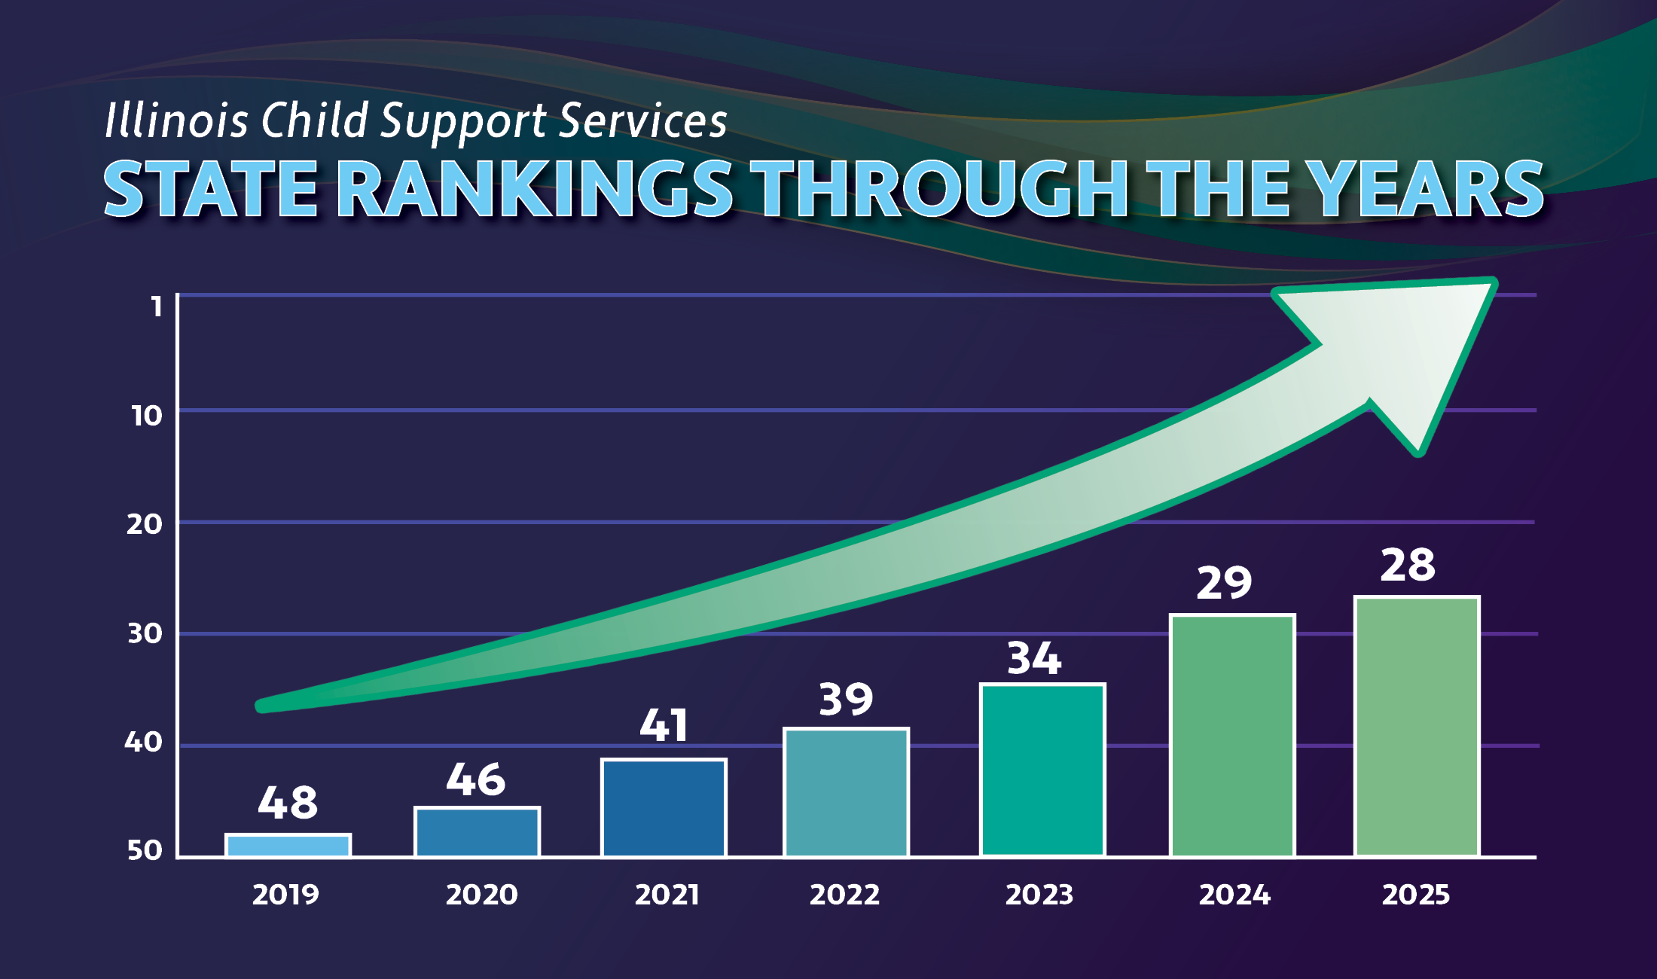

Finishing Out the Year Strong!
State Rankings through the years
We once again made tremendous strides last year and are on track to continue that momentum through this FFY 2025. All metrics currently at or above where we were at this time last year! (Accurate?) Together we can make 2025 our strongest year yet!

Slide 36
Finishing Out the Year Strong!
We once again made tremendous strides last year and have continued that momentum through FFY 2026. Currently, each of our metrics are at or above where we were in August of last year!
Together we are making 2026 our strongest year yet!

