Slide 1
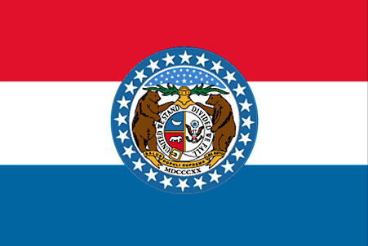
Good Neighbors: Missouri
Lara Webb Fors, J.D.,
Assistant Prosecuting Attorney, Trial Team Leader, Jackson County
Kansas City, MO
2026 ILLINOIS CHILD SUPPORT CONFERENCE, Marion, IL
Virtual, September 28-29

Slide 2
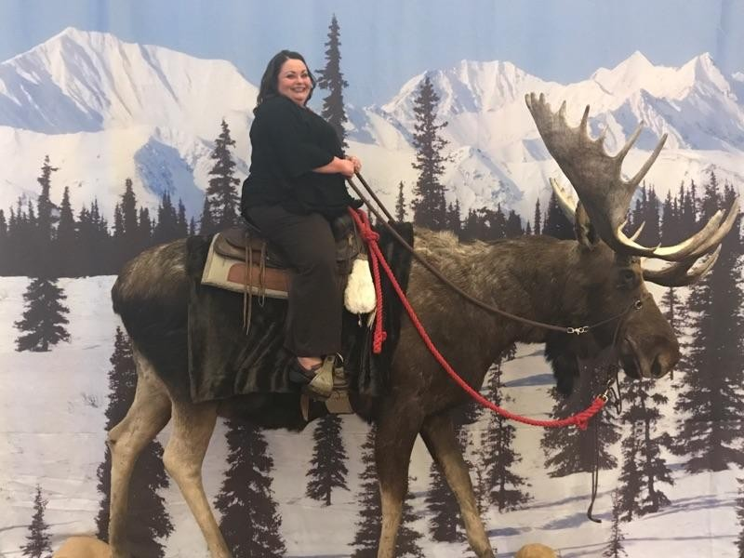
Speaker:
Lara Webb Fors

Slide 3
Session Description
Join me for a discussion on how the child support program works in Missouri with a focus on the impact of intergovernmental cases. The goal is to make working with this neighbor to the southwest, with urban and rural areas, smoother and more efficient. This session will highlight questions that may arise when there are differences in processes between the Missouri and Illinois programs for the establishment, modification, and enforcement of child support cases. I will offer some helpful info and tips for Illinois state CS and AG child support professionals. Please bring your general questions for discussion.

Slide 4
Agenda
Facts about your neighbor, Missouri (MO)
MO UIFSA Cases
Tools MO Uses
Considerations if MO establishes an order
Considerations of MO modifies an order
Considerations if MO enforces an order
Questions/Discussion
Helpful Resources/Links

Slide 5
Fun Facts about MO
“Show Me State” – “For thy eloquence neither convinces nor satisfies me. I am from Missouri. You have got to show me.”--Congressman Willard Duncan Vandiver, 1899
Historians believe that people may have inhabited the land now known as Missouri as many as 20,000 years ago. More recently, Native American tribes, including the Chickasaw, Illini, Missouri, and Osage, lived on the land. In fact, Missouri gets its name from the Missouri tribe. Missouri comes from the word ouemessourita, which basically means “wooden canoe people” or “people of the big canoes.”
  Makes sense—we have 2 of the biggest rivers: Missouri and Mississippi

Slide 6
Fun Facts about MO
St. Louis Gateway Arch is the tallest man-made monument in the US, standing at 630 ft
Ice cream cone was invented at the 1904 World’s Fair in St. Louis when an ice cream vendor ran out of cups and asked the waffle vendor to help him by rolling them up –the waffle cone!
St. Joseph was home of the Pony Express, mail delivery system for nearly 200 relief stations between April 1860 and October 1861 between MO and California
Kansas City is home to more than 200 fountains, second only to Rome, Italy

Slide 7


https://pixels.com/featured/jc-nichols-fountain-and-kansas-city-plaza-1x1-gregory-ballos.html

Slide 8
Fun Facts about MO
In 1904, St. Louis was first US city to host the Summer Olympic Games
Red’s Giant Hamburger on Route 66 in Springfield had the first drive-through window in US
Birthplace of President Harry Truman, author Mark Twain, inventor George Washington Carver, outlaw Jesse James, and the unsinkable Molly Brown
Besides the birthplace of Lara, Chillicothe, MO, is the birthplace of sliced bread
And—we’ve got Branson and Patrick Mahomes!

Slide 9
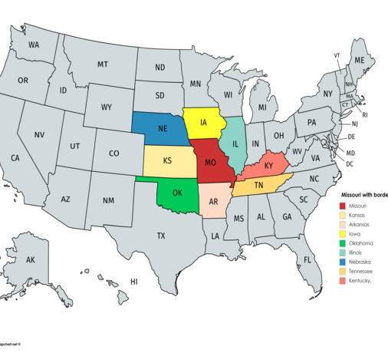

MO has 8 border states!

Slide 10
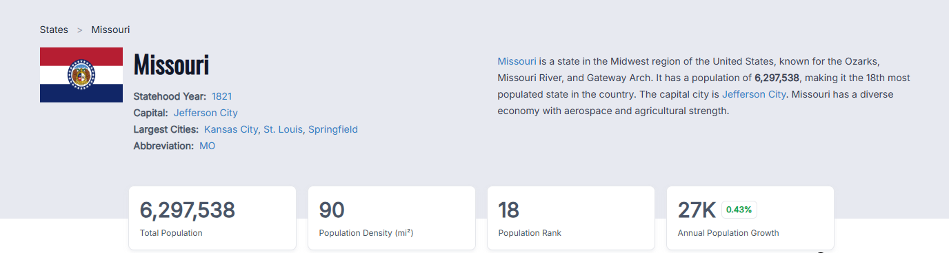
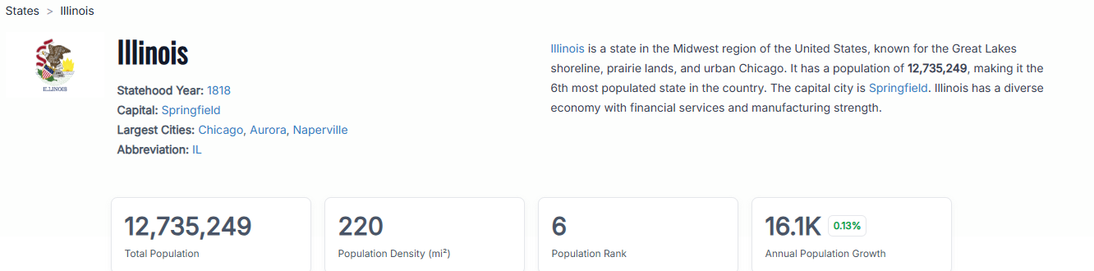
https://worldpopulationreview.com/states/missouri

Slide 11
Comparing State Demographics https://www.census.gov/quickfacts/fact/table/MO/PST045224
MO
IL
Population: 6.27 M
Median gross rent (2020-24): $1,033/mon
Median household income (2024): $70,702/year
Persons in poverty: 12.3%
Population: 12.72 M
Median gross rent (2020-24): $1,274/mon
Median household income (2024): $83,390 /year
Persons in poverty: 11.6%

Slide 12
Comparing MO and IL IV-D Cases 2025
FY2025 Preliminary Data Report and Tables, E-Flash Update 8/3/2026
MO
IL
FTE: 709
Case load: 278,068
Assistance Type
  Current: 8,244 (2.97%)
  Former: 162,260 (58.35%)
  Never: 107,564 (38.68%)
Paternities Established: 21,967
# of children in caseload: 383,764
FTE: 921
Case load: 309,672
Assistance Type
  Current: 31,419 (10.15%)
  Former: 119,443 (38.57%)
  Never: 158,810 (51.28%)
  Paternities Established: 50,394
# of children in caseload: 307,820
Notes:
We both lost staff from 24 to 25
FTE: 709 p-81
Case load: 282,153 p-52
Assistance Type
Current: 9,800 (3.5%) p-55
Former: 164,634 (58.3%) p-56
Never: 107,719 (38.2%) p-57
Paternities Established: 22,381 p-71
# of children in caseload: 386,196

Slide 13
Missouri IV-D Facts
State administered, state run
Uses administrative process
TANF and Medicaid require cooperation with the IV-D agency
Foster care referrals have basically come to a stop
Statewide caseload; 14 offices statewide plus special units in Central office
Intake Center for mail processing, case initiation, and document management
Makes referrals to county prosecutor offices or the Missouri Attorney General’s offices for legal action
Has paused license suspensions pending litigation
Automated system is called MACSS (Missouri Automated Child Support System—sounds like MAX)—getting face lift, due October 5, 2026!
Has a website portal for parents (and can see recent payments)
New Directors for DSS, FSD, and Deputy for Child Support in the last year

Slide 14


https://dss.mo.gov/child-support/
The Family Support Division
Notes:
Here’s what our website looks like, link at the top

Slide 15

Prosecutor Referrals
114 Counties are either Level A, B, or C
Single County (31)
Regional Offices

Slide 16
MO Law
Statutes for IV-D Agency and UIFSA: Chapter 454, see §454.440 for the enabling statute; §454.1500 for UIFSA;
MO’s Uniform Parentage Act: §210.817, et seq
Case law for contempt
Criminal non-support: §565.040

Slide 17
Comparing State UIFSA Cases
MO
IL
Interstate collections forwarded to another state: $25,107,359
Interstate cases sent out to another state: 20,137
Interstate cases received from another state: 15,945
Interstate collections forwarded to another state : $51,954,133
Interstate cases sent out to another state: 13,863
Interstate cases received from another state: 25,246
Notes:
Interstate collections forwarded to another state:: $26,089,121 p-33
Interstate cases sent out to another state: 21,137 p-34
Interstate cases received from another state: 16,174 p-35

Slide 18
MO UIFSA Cases
Outgoing Referrals
PATE/ESTA/MODI referrals are completed by PA offices, county where applicant resides
MO generally prefers long-arm cases, so a referral may be a 2nd attempt
ENFO referrals are completed by the agency
Incoming Referrals
Administrative process is used first
Judicial referral is made to a PA if legal action is needed
Needed for IWO to MO Department of Labor for unemployment benefits

Slide 19
Tools MO Uses
CSENet
MO shares both financials and case activities on QUICK (same as IL)
MO uses EDE (same as IL)
MO is not on the OCSE Communications Portal (Neither is IL)
MO has the 3-parent VAP; has a 2-year SOL to disestablish paternity §210.854
We e-file pleadings; website is case.net, www.courts.mo.gov
Notes:
I think IL has only the 2 parent VAP

Slide 20
Considerations when MO Establishes an Order
Minimum Wage: MO: $15/hr. IL state: $15.00/hr; Chicago: $16.60/hr; Cook County: $15.40/hr
Most courts do not impute income for calculating child support for incarcerated NCPs (post-conviction), but most will get a $0 order*
MO does not automatically calculate interest and record it in MACSS
Emancipation is 18, with exceptions, and can delay until age 21
MO guidelines are an income shares model, referred to as the Form 14
  See, general, child support forms approved by the MO Supreme Court
MO treats the Title II disability benefit amount differently on the cs guidelines
Notes:
I don’t think either state’s min wage is going up for 2027; Chicago’s goes up every ear on July 1 by the Consumer Price Index or 2.5%, whichever is less
*Form 14 rule that court can impute wages to incarcerated parents, unless when a parent paying support is sentenced to be incarcerated for at least six consecutive months from the date the support order is entered, actual income, and not imputed income, shall be used.
SS Title 2 benefits received by child—looks like it is income to the parent worker https://hfs.illinois.gov/content/dam/soi/en/web/hfs/sitecollectiondocuments/standalonesupportobligationworksheet.pdf

Slide 21
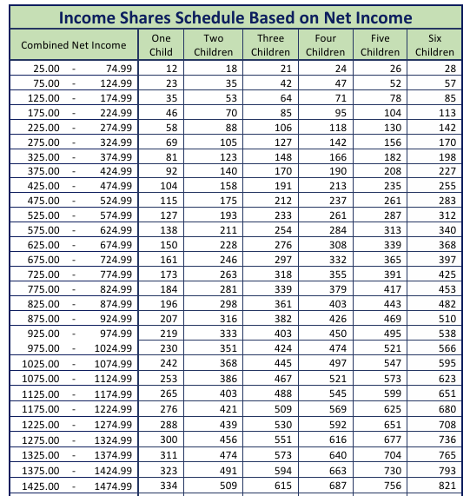
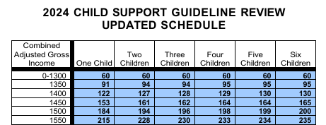
Comparing Guidelines up to c. $1,500 /mon
Notes:
IL’s chart maxes out around $27,000/mon; MO maxes out at $40,000/mon; MO uses gross income; IL uses calculates to net income for their chart

Slide 22
Considerations when MO Modifies an Order
If it is not a MO order, MO PA office will register the order in the county where the non-moving party resides
FSD agency may administratively modify it and send order to the AG’s office to have it filed with the court
MO notifies the parents on a case when the NCP is incarcerated post-conviction, but does not initiate a modification without a request from a parent
Now MO’s interest rate picks up, 1% per month
Will ask IL to let us know when current child support should stop accruing

Slide 23
Considerations when MO Enforces an Order
MO does not pass through any current support collected to CP when CP is receiving TANF
MO uses administrative process to enforce first
If MO cannot get payments with administrative process, FSD will send a referral to the PA office to register an out of state order for enforcement and judicially enforce
PAs use civil contempt or criminal non-support
There is not abatement of current while an NCP is incarcerated
MO does track futures when an NCP has overpaid
Voluntary payments can be mailed, auto-withdrawn, PayNearMe, or made online (some circuit clerks will accept it if ordered by the Court)

Slide 24
Court Considerations in MO
Timeframes of referral
  FSD may have had the referral for a long time before it is sent to the PA; UIFSA packet will need to be updated with a new certified arrears calculation and matching Letter of Transmittal
Time to serve and get court dates
Paternity—prefer to reach out to the out-of-state CP directly

Slide 25
Questions/Discussion
What questions do you have that I missed?
What concerns do you have with MO?
How can we improve?

Slide 26
Resources
Map of counties and regional project offices
List of counties and FIPS codes; which PA is handling it

Slide 27
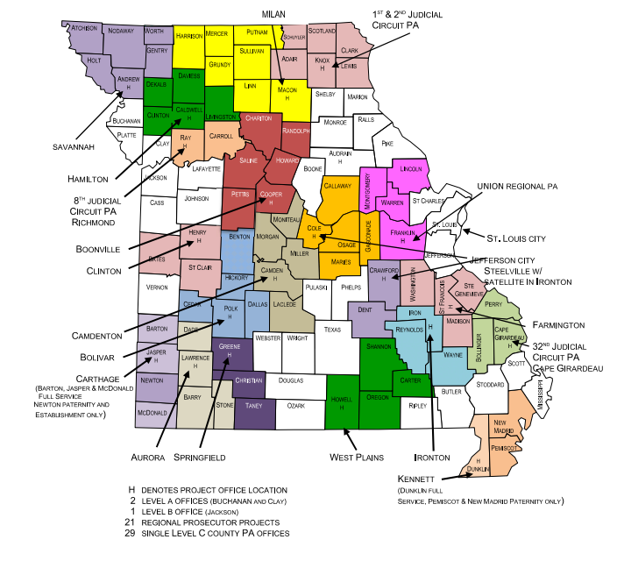

Slide 28
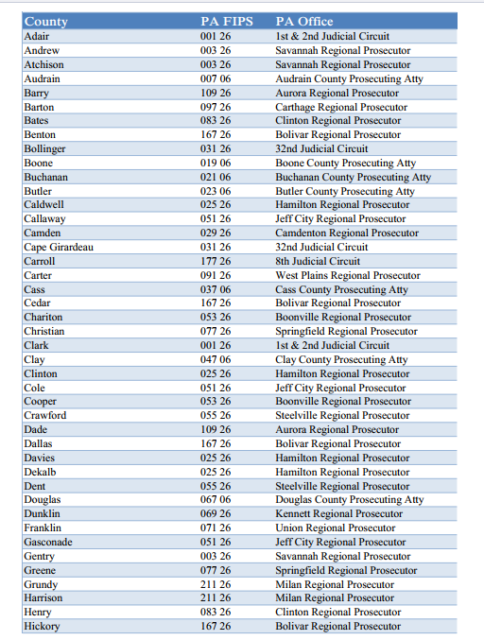

Slide 29
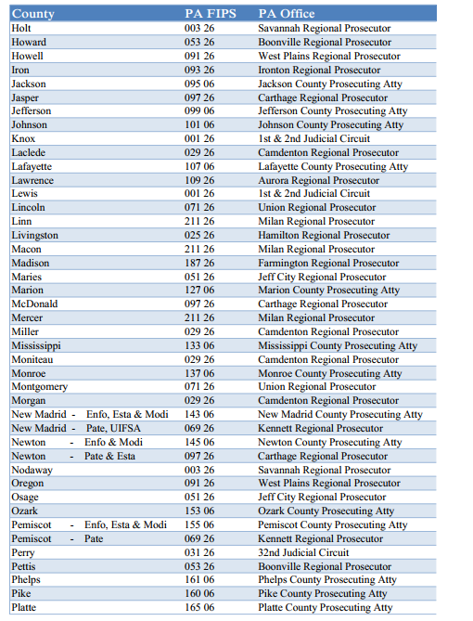

Slide 30
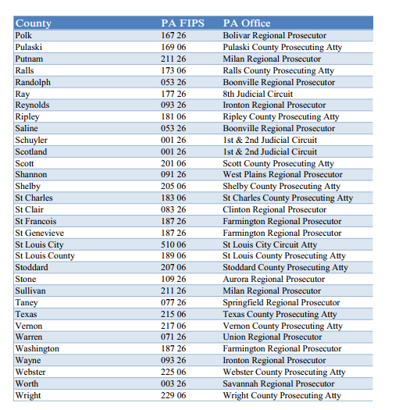

Slide 31
Helpful Links
MO Family Support Division https://mydss.mo.gov/
Bureau of Vital Records https://health.mo.gov/data/vitalrecords/
MO Statutes https://revisor.mo.gov/main/Home.aspx
MO Case.net https://www.courts.mo.gov/casenet/welcome.do
MO child support forms https://www.courts.mo.gov/page.jsp?id=638
MARCH Mediation

Slide 32
Thank you!
Lara Webb Fors, APA (she/her)
Trial Team Leader
Jackson County Prosecutor’s Office
Family Support Division
324 E. 11th Street, Suite 1100
Kansas City, MO 64106-2421
P: (816) 881-3514
F: (816) 881-3174
LFors@jacksongov.org
Lara.W.Fors@dss.mo.gov

