Slide 1
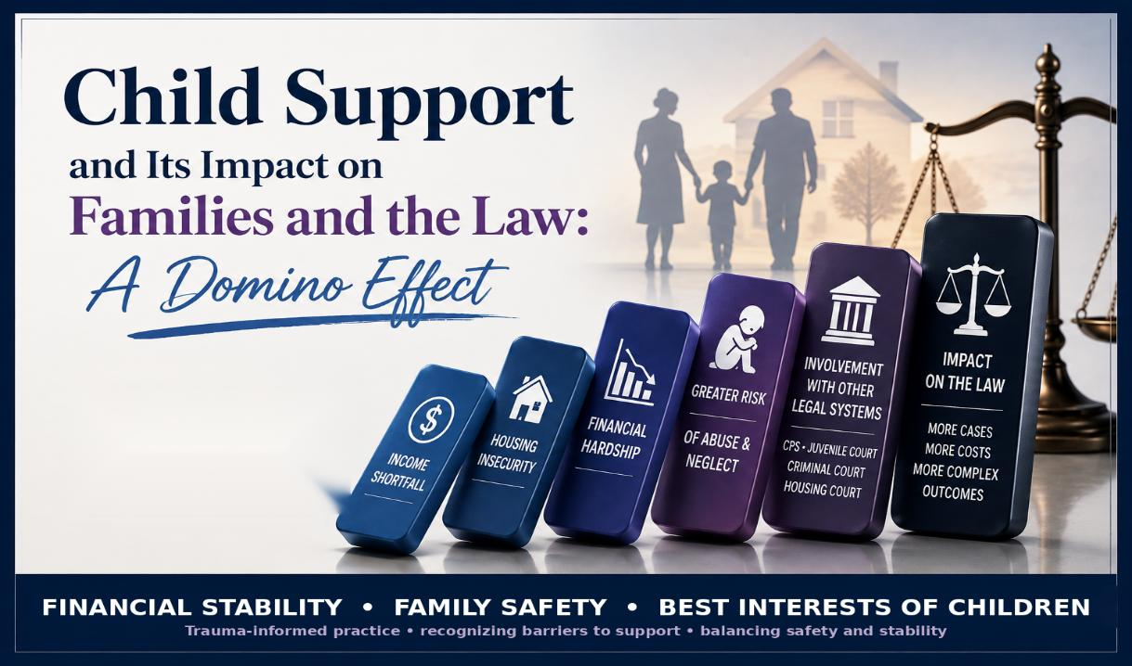
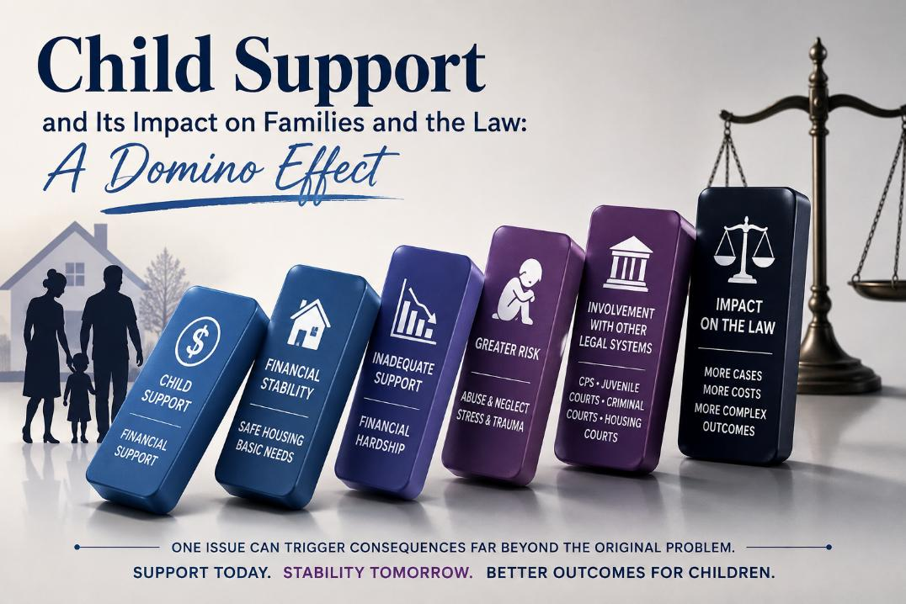
Child Support and Its Impact on Families and the Law: A Domino Effect
Amanda Byassee Gott
At Large Circuit Judge
1st Judicial Circuit of Illinois
Williamson County, Illinois

Slide 2
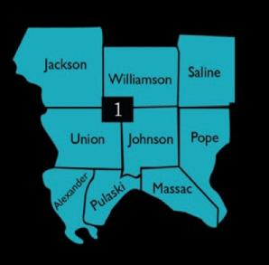
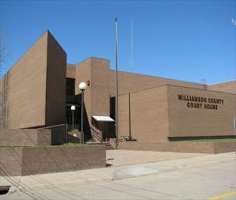
Judge Amanda Byassee Gott
At-Large Circuit Judge • First Judicial Circuit of Illinois
Judicial Experience
Elected November 2018
1st Judicial Circuit of Illinois
Southernmost 9 counties of Illinois
Adoptionss
Orders of Protection
Juvenile
Abuse • Neglect • Truancy • Delinquency
Family
Conflict or Juvenile Related
Williamson County Courthouse
Marion, Illinois
First Judicial Circuit
Family Practitioner for almost 20 years before becoming Judge.
Court Approved Guardian ad Litem and Mediator throughout Southern Illinois
Williamson County Courthouse: 200 West Jefferson Street, Marion, Illinois.

Slide 3
Presentation Objectives
By the end of this presentation, participants will be able to:
1
Explain
the importance of child support to the financial stability and well-being of children and families.
2
Identify
how inadequate financial support can contribute to housing insecurity, financial hardship, abuse and neglect, and involvement with other legal proceedings.
3
Recognize
barriers some parents face in seeking or enforcing child support, including domestic violence, abuse, neglect, and coercive control.
4
Apply
trauma-informed approaches while balancing family safety, financial support, and the best interests of children.
The Domino Effect: financial stability → family stability → legal and safety consequences
Child Support and Its Impact on Families and the Law: A Domino Effect

Slide 4
This Presentation Examines
Financial stability: How reliable child support can promote housing, food, health, education, and family stability.
The domino effect: How inadequate or unrealistic support can contribute to financial hardship, housing insecurity, abuse and neglect and involvement with other legal systems.
Safety and trauma-informed practice: Why domestic violence, abuse, neglect, coercive control, privacy, and retaliation concerns must be considered, recognizing the barriers some parents face in seeking or enforcing child support while balancing safety and the best interests of children.
Best Practices: How child support enforcement best practices can be established and improved to improve outcomes for families.

Slide 5

CHILD SUPPORT LAWS:
Federal and State
There are numerous laws to assist litigants in establishing and enforcing child support
Notes:
Sources:
Visual asset: AI-generated courthouse and family legal imagery created for this deck.

Slide 6
Federal Framework:
Title IV-D and Interstate Enforcement
Title IV-D
Uniform enforcement
Across state lines
Part D of Title IV of the Social Security Act funds state programs that locate parents, establish parentage and orders, collect payments, and enforce obligations.
Federal law requires income withholding, state and federal tax refund offsets, reporting, liens, passport denial, and data matching tools.
UIFSA provides the state-law process for interstate cases. The Full Faith and Credit for Child Support Orders Act requires recognition of qualifying orders.
Key federal principle
Support enforcement is designed to follow income and assets. Employers, financial institutions, state agencies, and federal databases are part of the collection network. Federal child support enforcement does not decide parenting time or custody.

Slide 7
Illinois Child Support Laws
Illinois Marriage & Dissolution of Marriage Act 750 ILCS 5/505
Illinois Parentage Act 750 ILCS 46/801
Illinois Domestic Violence Act 750 ILCS 60/214(12)
Illinois Juvenile Court Act 705 ILCS 405/2-23; 1-3
Illinois Uniform Interstate Family Support Act 750 ILCS 22/1
Illinois Public Aid Code 305 ILCS 5/10-15.1
Probate Act may also be involved:
Guardianship by Family or DCFS does not automatically end the parent-child relationship and child support may still be ordered to be paid by parent to DCFS or Guardian

Slide 8
Illinois Program Snapshot
Illinois HFS administers the statewide child support program and the State Disbursement Unit.
Illinois services include
$978 million
Locating parents and establishing parentage
Establishing support administratively or through court
Income withholding and unemployment intercepts
State and federal tax refund intercepts
Property liens and certain license suspensions
Interstate establishment and enforcement assistance
collected and disbursed in Illinois during fiscal year 2024
Includes Title IV-D and non-Title IV-D collections processed through the State Disbursement Unit.
Approximately $2.6 billion in unpaid child support was owed in Illinois as of June 2023
Chicago Sun Times
65%
of current support due was collected nationally in FY 2024

Slide 9

CHILD SUPPORT
Child support is both a family resource and a legal system connecting courts, employers, agencies, and public benefits.
Why Does Child Support Matter?
Notes:
Sources:
Visual asset: AI-generated courthouse and family legal imagery created for this deck.

Slide 10
Impact on Families
Housing and food
Health & education
Parent relationships
Regular support helps stabilize essential household expenses.
Orders may address insurance, uncovered medical costs, childcare, & school-related needs.
Disputes over payment may intensify conflict, but support & parenting time are legally separate duties.
Employment & credit
Public benefits
Children’s well-being
Withholding promotes regular payment. Arrears, liens, and enforcement actions can complicate financial recovery.
Child support may supplement family income and may interact with TANF, Medicaid, and assignment or distribution rules.
Predictable resources and reduced parental conflict support stability; conflict and inconsistent payment can undermine it.

Slide 11

Benefits of Child Support
Provides regular financial support for food, housing, clothing, education, transportation, and health needs.
Allocates responsibility between parents after separation, divorce, or when parents were never married. (This can reduce arguments and conflict between parents by having set clear obligations and responsibility on the part of both parents.)
Reduces reliance on public assistance when payments are consistent and realistic.
Creates legal consequences for enforcement of unpaid orders, including arrears, withholding, liens, license action, and contempt.

Slide 12
More Positives: Prevent Neglect and Removal
A minor under 18 without proper support, education, medical or other care necessary for the minor, including inadequate food, clothing, shelter, who is abandoned or left without adequate supervision, or in an environment injurious to their welfare… 705 ILCS 405/2-3 Illinois Juvenile Court Act
Over 550,000 children are victims of abuse or neglect in the US each year *
Nationally, neglect is the most common form of abuse. Nearly 4/5 (79%)
Illinois: Over 15,000 youth in the care of the DCFS as of June 30, 2026
Lack of Income/
Employment
Food
Insecurity
Housing
insecurity
Transportation Issues
Education Issues
Lack of
Supervision
These are all issues for which child support would be of assistance for families and children. *Statistics from National Childrens Alliance

Slide 13


A Domino Can Fall in Either Direction
The direction of the next domino may depend on the circumstances surrounding the first.
CHILD
SUPPORT
ONE DIRECTION
CIRCUMSTANCES MATTER
ANOTHER DIRECTION
Support → Stability → Safety
Instability → Crisis → Court
The same legal issue can lead to very different outcomes depending on safety, resources, family circumstances, and available support.
Domino photograph: Kurt:S, Wikimedia Commons, CC BY 2.0; mirrored for visual comparison.

Slide 14


Negative Consequences
Creates stability for one household but place a financial strain on another
Establishes a legal parentage relationship that a parent may be trying to avoid due to domestic violence, abuse, neglect and safety threats to the family.
May impact public benefits and other income related assistance.
May result in additional legal action for parenting time, responsibilities (formerly custody and visitation), create animosity and conflict between parents or family.

Slide 15
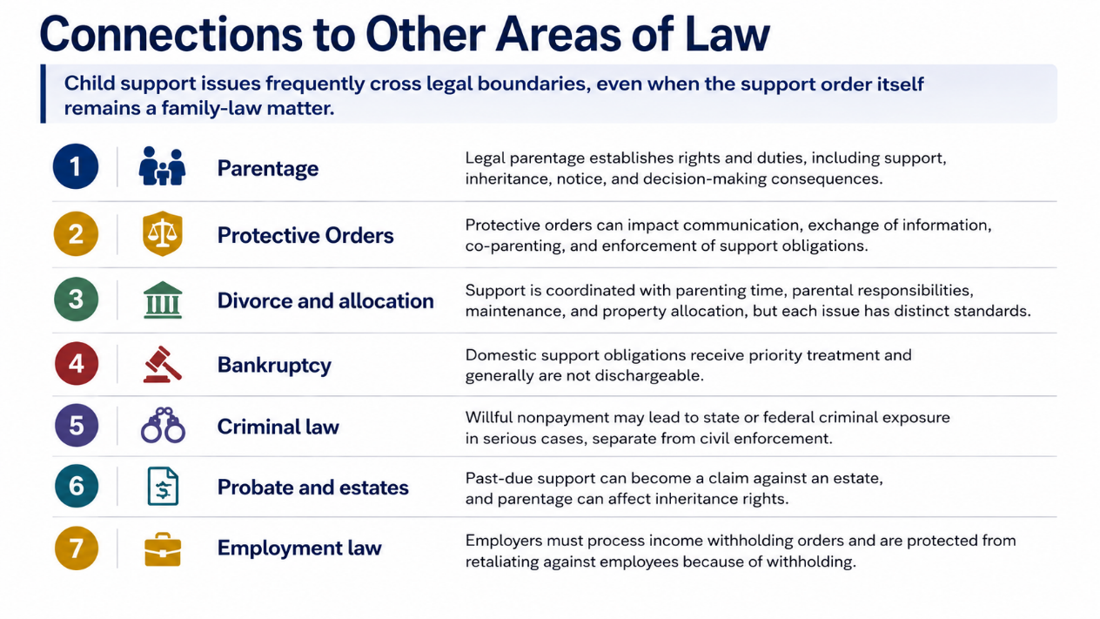
Connections to Other Areas of Law
Child support issues frequently cross legal boundaries, even when the support order itself remains a family-law matter.
1
Parentage
Legal parentage establishes rights and duties, including support, inheritance, notice, and decision-making consequences.
2
Divorce and allocation
Support is coordinated with parenting time, parental responsibilities, maintenance, and property allocation, but each issue has distinct standards.
3
Bankruptcy
Domestic support obligations receive priority treatment and generally are not dischargeable.
4
Criminal law
Willful nonpayment may lead to state or federal criminal exposure in serious cases, separate from civil enforcement.
5
Probate and estates
Past-due support can become a claim against an estate, and parentage can affect inheritance rights.
6
Employment law
Employers must process income withholding orders and are protected from retaliating against employees because of withholding.

Slide 16
THE ACCESS-TO-JUSTICE CHALLENGE
Why the Illinois child support process can be difficult for self-represented litigants
Law + forms + math + evidence + hearings
It’s not as easy as they claim...
Notes:
Sources:
Visual asset: AI-generated courthouse and family legal imagery created for this deck.

Slide 17
Self Representation: the gap is large
Access to Justice
Family and child support cases are among the areas where “doing it alone” is common.
93/102
65.2%
92%
Civil cases outside Cook County with at least one self-represented litigant in 2015.
Civil legal problems of low-income Americans that received no or inadequate legal help.
Illinois counties reported 50% or more civil cases had at least one self-represented litigant.
The result is not simply inconvenience. Parents may leave without an order, accept an order they do not understand, fail to address health insurance or childcare, or struggle to modify an order when life changes.
Notes:
Sources:
Illinois Courts reported that 93 of 102 counties had 50% or more civil cases with at least one self-represented litigant and 23% of Illinois residents did not speak English as their primary language: https://www.illinoiscourts.gov/News/902/How-to-improve-access-to-justice-in-Illinois-These-4-programs-lead-the-way/news-detail/. The Illinois State Bar Association reported AOIC data that 65.2% of civil cases outside Cook County had at least one self-represented litigant in 2015: https://www.isba.org/barnews/2017/09/20/pro-se-revolution. The Legal Services Corporation 2022 Justice Gap Report states that 92% of the civil legal problems of low-income Americans did not receive any or enough legal help: https://www.lsc.gov/initiatives/justice-gap-research.

Slide 18
Common legal and practical barriers
What makes it difficult
Financial affidavits
Service and notice
Required income and expense information can be confusing, incomplete, or hard to document.
A valid case often requires proper service, notice, proof of mailing, and updated addresses.
Parenting time effects
Health care and childcare
Support calculations can change when shared physical care or split care applies.
Orders need to address insurance, uncovered medical costs, childcare, school, and activity expenses.
E-filing and forms
Language and technology
SRLs must choose forms, complete them correctly, file electronically, and track court dates.
Limited English, limited internet, disability access, transportation, and work schedules can block participation.
The hardest parts are often not obvious until a parent is already in the system.
Notes:
Sources:
Illinois Courts provides court forms, e-filing information, language access help, and self-represented litigant resources, showing the range of procedural tasks involved: https://www.illinoiscourts.gov/self-help/self-help/self-help/. 750 ILCS 5/505 addresses shared physical care, split care, health care, childcare, school expenses, and other support components that can make the calculation difficult for nonlawyers: https://www.ilga.gov/documents/legislation/ilcs/documents/075000050k505.htm.

Slide 19
Illinois Law: How Support Is Determined
The income-shares model is policy-driven and worksheet-dependent.
Formula complexity
Determine each parent’s monthly net income
Where SRLs get stuck
1
Burden of Proof
2
Combine monthly net incomes
Having Evidence of Income
Knowing which income numbers to use
Understanding net income conversions
Handling self-employment or cash income
Calculating shared parenting time
Knowing when deviations are allowed
Presenting add-on expenses correctly
3
Apply the schedule for the number of children
4
Calculate each parent’s percentage share
5
Adjust for parenting time, health care, childcare, school, or split care issues
OTHER ISSUES:
DURATION
MODIFICATION
ENFORCEMENT
Notes:
Sources:
Illinois Income Shares Guidelines became effective July 1, 2017, and the Illinois schedule and standardized net income table are now updated annually; 2026 amounts became effective March 20, 2026: https://hfs.illinois.gov/childsupport/parents/incomeshares.html. 750 ILCS 5/505 describes the steps to determine monthly net income, combine net incomes, apply the schedule, and calculate each parent’s percentage share; it also addresses childcare, health care, shared physical care at 146 or more overnights, and split physical care: https://www.ilga.gov/documents/legislation/ilcs/documents/075000050k505.htm.

Slide 20
Where the system can reduce hardship
The goal is not to discourage support orders. The goal is to make orders safer, clearer, and more accurate.
Practical fixes
One-page roadmap
Plain-language checklist
Safety screening
Show whether a parent should start with HFS, circuit clerk, legal aid, or emergency safety resources.
Income documents, pay stubs, tax returns, childcare proof, insurance, parenting schedule, and service information.
Ask about domestic violence, address confidentiality, orders of protection, and safe communication before filing.
Court-day help desk
Modification warning
Better handoffs
Forms, e-filing, fee waivers, continuance requests, and referrals to limited-scope legal assistance.
Every order and notice should clearly state: life changes do not automatically change the amount.
HFS, circuit clerks, self-help centers, legal aid, and juvenile court stakeholders should use consistent referral language.
Unfortunately, upcoming changes to child support law may make the process more difficult for SRLs
Notes:
Sources:
Illinois Courts Access to Justice materials emphasize standardized plain-language forms, navigators, language access, and court personnel guidance for self-represented litigants: https://www.illinoiscourts.gov/News/866/Advancing-Access-to-Justice-in-Illinois-Introducing-the-20172020-ATJ-Commission-strategic-plan/news-detail/. Illinois Courts self-help resources include Illinois Court Help, forms, language access, and e-filing support: https://www.illinoiscourts.gov/self-help/resources-for-selfrepresented-litigants/.

Slide 21

FAMILY VIOLENCE AND SAFETY:
Safety Concerns in Establishing Support
Domestic Violence, Abuse and Neglect Concerns, Involvement with Public Benefits and Other Court systems can create additional barriers and concerns for families
Does the Harm outweigh the Benefit
Unknown Author is licensed

Slide 22
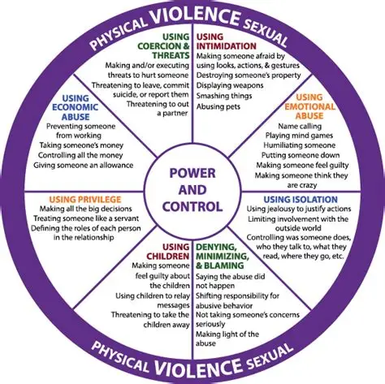
Child support helps families, but the process can create risk
The downside is usually not the concept of support. It is what may happen when the case forces contact, disclosure, or conflict.
Benefits
Child support is critical income that can stabilize food, housing, childcare, and health care for families.
Risks
Child Support can trigger retaliation, litigation, or renewed control by establishing parentage, requiring location disclosure, and confrontation with abusers at court hearings.

Slide 23

Why some parents do not seek child support
The decision often involves safety, stability, and control concerns that are not visible in a payment calculation.
Domestic violence
A support case can alert an abusive parent, revive contact, or provoke threats.
Abuse/ neglect allegations
A parent may fear retaliation through DCFS reports, custody filings, or accusations of poor care.
Location and privacy
Court filings, service, employment records, and notices may expose sensitive information.
Financial control
Payments may be used to demand access, punish the other parent, or manipulate the child.
System distrust
Parents may fear being judged, losing benefits, or being blamed for poverty.

Slide 24

Safety and family dynamics complicate the decision
The legal process can increase contact, conflict, or fear. Domestic Violence Survivors may need support and safety at the same time. Systems should not force them to choose one or the other.
Domestic violence, Retaliation and control
An abusive parent may use support, parenting time, or court filings as leverage.
Threats after service of process or hearing notices.
Pressure to drop the case or accept informal payments.
Use of support disputes to demand parenting time.
Stalking through employer, address, court, etc.
Escalation when wages, tax refunds, licenses, or accounts are affected.
Notes:
Sources:
HFS Child Support Services Program fact sheet states DCSS may use an administrative process or circuit court and that judicial process may be necessary when the family may be at risk of domestic violence: https://hfs.illinois.gov/childsupport/formsbrochures/hfs1759.html. Illinois Courts self-help resources include safety and order-of-protection information for people without lawyers: https://www.illinoiscourts.gov/self-help/self-help/self-help/. Visual asset: AI-generated mediation/family office scene created for this deck.

Slide 25
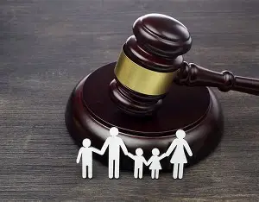

Abuse or neglect concerns can discourage action
A parent may avoid child support because opening a case could trigger a larger family conflict which may include DCFS involvement.
The other parent may file false reports, seek custody, or threaten relatives.
Fear of retaliation
A parent may fear that court contact gives an unsafe parent more access to the child.
Abuse concerns
Neglect confusion
Financial hardship can be mistaken for lack of care if not properly understood.
Mandated reporter anxiety
Parents may avoid schools, doctors, courts, and agencies if they fear scrutiny.
While Poverty is not a basis for removal for abuse and neglect, the domino can easily fall either direction, since financial instability, housing insecurity and lack of resources can be the basis for neglect.

Slide 26

Juvenile Law: Where Child Support Intersects
Juvenile court focuses on safety, best interests, rehabilitation, and permanency.
Child support may be relevant issue in these cases, but rarely the sole legal issue.
Abuse, neglect, and dependency
A child’s lack of necessary support, care, food, clothing, shelter, education, or medical care may be relevant to neglect. Courts must distinguish poverty from parental disregard or refusal.
Delinquency/ Truancy
Family instability, housing insecurity, unmet needs, and parental conflict may affect risk and rehabilitation planning. Financial circumstances alone are not a basis for committing a youth to the Department of Juvenile Justice.
Permanency and placement
When custody changes to a relative, foster parent, guardian, or the State, support obligations and payment direction may need review so resources follow the child’s placement.

Slide 27

Public benefits can pressure parents to cooperate
For TANF families, child support cooperation can be required unless good cause applies.
Pressure point
A parent receiving TANF may have to identify the other parent, help establish parentage, and participate in child support proceedings.
Illinois recognizes good cause concerns including domestic or sexual violence, emotional harm, rape, incest, and adoption related issues.
Good cause
A survivor may not know good cause exists, may not trust the process, or may lack safe documentation.
Risk

Slide 28

ESTABLISHING BEST PRACTICES
Balancing financial support, privacy, safety, and the best interests of children
A trauma informed approach
Unknown Author is licensed

Slide 29

Being Trauma Informed: What does it mean
Understanding how past trauma affects a person's behavior, memory, and reactions so the legal system can avoid re-traumatizing them and handle cases more fairly and without causing further harm.
Key Principles
Recognize Trauma
Avoid Retraumatization
Promote Safety & Trust
Empower Litigants

Slide 30
Core Principles in Legal Representation
Safety: Creating safe and secure environment in every interaction.
Trustworthiness & Transparency: Communicating openly, clarifying roles, and following through reliably.
Empowerment & Choice: Involving Client directly in decisions.
Collaboration: Treating the attorney-client relationship as an equal partnership
Cultural Sensitivity: Accounting for cultural, historical, and identity-based factors that shape a client's experience
Trauma-Informed Legal Practice: Principles and Application 30 July 2025 Law Society of Tasmania

Slide 31
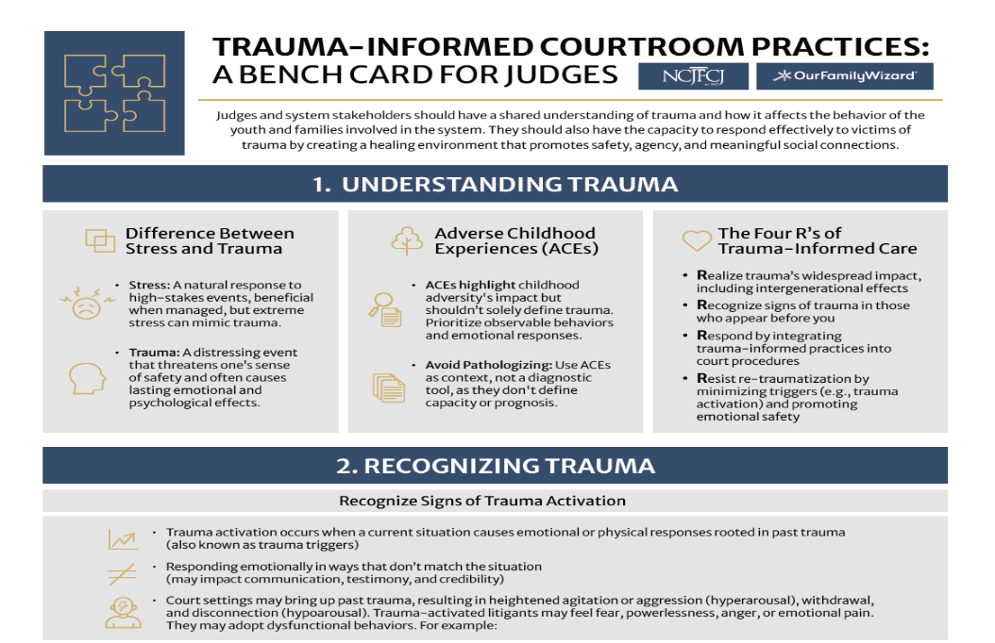

Slide 32
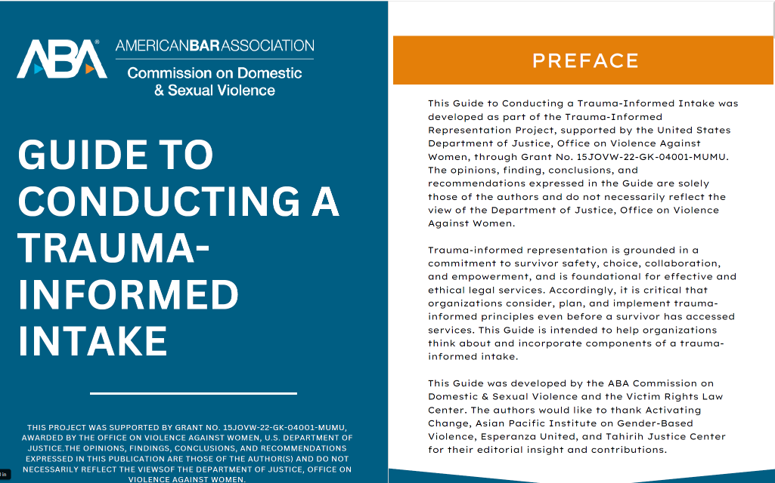

Slide 33

Practical safeguards before opening a case
A safer child support process screens for risk before the other parent is contacted.
1
Screen first
Ask privately about violence, stalking, coercive control, and child safety.
Plan notice
Consider timing, confidential address practices, and safe communication channels.
2
Separate issues
Be clear that child support collection is a separate issue from parenting time issues
3
4
Protections
Coordinate with legal aid, victim services, DCFS, and court safety resources.
5
Good cause
For TANF or benefit cases, evaluate good cause before sanctions or referrals.
Goal: Maximize lawful support while minimizing danger, retaliation, and unnecessary court involvement.

Slide 34
Decision framework: Risk vs. Benefit of Child Support
This framework is not a reason to deny support. It is a reason to design a safer path.
Will notice, parent locate, hearings, or enforcement increase danger?
Access
Will the other parent use support to demand contact or unsupervised parenting time?
Safety
Are abuse, neglect, dependency, or DCFS concerns already present?
Is cooperation required, and has good cause been considered?
Child welfare
Benefits
Can address, employer, school, and medical information be protected?
Is there a safer legal route, support order structure, or referral?
Privacy
Alternatives
The best outcome is not simply an order.
It is a support system that does not place the parent or child at greater risk.

Slide 35

Good Clause Claim:
Illinois Department of Human Service
The client may claim that cooperation with the CSE process is not in their best interest or the best interest of the child…
Tell client of their right to claim "good cause" for noncooperation.
Child support actions are not taken as long as good cause exists…
The client may claim good cause for noncooperation with the CSE process when:
the child was conceived as a result of incest or rape;
there is a possibility the child is going to be adopted out;
there may be emotional harm to the client or the child;
there has been domestic or sexual violence, or there is fear/risk of it.
PM 24-02-04-b: Determination of Good Cause https://www.dhs.state.il.us/page.aspx?item=18870

Slide 36
Confidential Addresses & Child Support in Illinois
Domestic violence concerns do not necessarily prevent a parent from seeking child support.
1
305 ILCS 5/10-10.5
State Case Registry
CONFIDENTIAL CASE INFORMATION
Information filed by the parties that is not specifically required in the body of the support order is not a public record and is treated as confidential.
2
305 ILCS 5/10-27
State Case Registry
WHEREABOUTS & SAFETY
State Case Registry safeguards must prohibit release of whereabouts information when there is a protective order, reasonable evidence of domestic violence or child abuse, or reason to believe disclosure may cause physical or emotional harm.
3
750 ILCS 60/203(b)
Domestic Violence Act
ORDER OF PROTECTION
In an order-of-protection proceeding, an address may be omitted from court documents when disclosure would risk abuse. If needed for jurisdiction or venue, it may be provided orally and in camera.
4
HFS Family Violence
Indicator
IV-D CHILD SUPPORT SERVICES
For IV-D cases, HFS may flag the case with a Family Violence Indicator so staff take extra precautions to protect personal information, including address information.
TRAUMA-INFORMED PRACTICE • A parent can seek financial support while legitimate safety concerns are addressed.
Illinois authorities: 305 ILCS 5/10-10.5; 305 ILCS 5/10-27; 750 ILCS 60/203(b); Illinois HFS/DCSS Family Violence Indicator.

Slide 37
IMDMA Child Support Statute Protections
750 ILCS 5/505(h)
“An order entered under this Section shall also include a provision requiring either obligor and obligee to advise the other of a change in residence within 5 days of the change except when the court finds that the physical, mental, or emotional health of a party or that of a child, or both, would be seriously endangered by disclosure of the party's address.” (emphasis added)

Slide 38
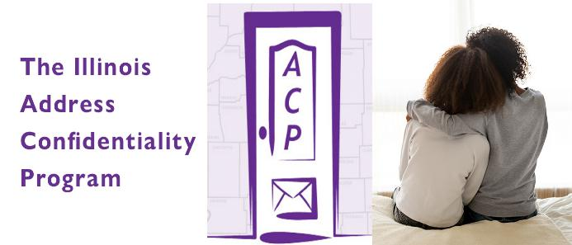
Address Confidentiality for Victims of Domestic Violence, Sexual Assault, Human Trafficking, or Stalking Act
750 ILCS 61/1 et seq,
ACP provides substitute address for victims of domestic violence, sexual assault, human trafficking, & stalking to use instead of home, school, or work addresses when interacting with State and local government agencies
Eligibility Requirements to Enroll in ACP
An adult who 1) has good reason to believe they are a victim of domestic violence, sexual assault, human trafficking, or stalking and 2) fears for their own safety.
A parent or guardian acting on behalf of a minor child, or a legal guardian acting on behalf of a person with a disability, who 1) has good reason to believe that the person they are acting on behalf of is a victim of domestic violence, sexual assault, human trafficking, or stalking and 2) they fear for that person’s safety.
All applicants must be physically located in Illinois or intend to move to Illinois soon.
The ACP does not require a police report or protective order as proof of the violence, and an applicant is not required to have reported the violence to law enforcement.

Slide 39
The Trauma-Informed Question
Instead of asking:
Why doesn't this parent just seek child support?
Consider asking:
What barriers or concerns—financial, legal, practical, or safety-related—may affect this parent's ability to seek or enforce support?
A safe process asks:
What could happen after the other parent receives notice?
Then address with the parent, what can be done to address their concerns
Be Prepared:
To Provide Resources, Answer Questions & Concerns, Give Referrals
Safety Screening
Confidential Address
Orders of Protection
Legal Aid
Referral

Slide 40

Conclusion
Child support should strengthen families without exposing children or parents to avoidable harm.
Financial support matters.
Safety screening matters.
Juvenile & Other Court consequences matter.
Good cause and confidentiality must be real, accessible options.
A child centered approach balances collection, protection, privacy, and permanency.

Slide 41


Make sure the Dominos fall in the direction that serves the best interest of children and families

