Slide 1
child support & THE MILITARY
An Introductory Guide to Child Support Enforcement involving Service Members

Slide 2
Army

Slide 3
NAVY

Slide 4
Air force

Slide 5
Marine corps

Slide 6
SPACE FORCE

Slide 7
Coast guard

Slide 8
1. Introduction
Disclaimer
EDUCATIONAL PURPOSES ONLY
NO OFFICIAL POSITIONS/OPINIONS STATED HEREIN
Notes:
As a quick housekeeping matter, while we are both here today in our official capacities to support this conference and the fine work done by its assembled membership and respective offices, the presentation is for educational purposes only. Neither of us are herein providing any opinions or official positions on behalf of our employers. Any statements in this presentation represent our own personal views and should not be relied upon or cited to in your actual casework.

Slide 9
1. Introduction
Who Are We?
Grant T. Swinger
Staff Attorney
U.S. Department of Veterans Affairs
Office of General Counsel
Office of Chief Counsel-Midwest District
Work Cell: (708) 901-4818
Email: grant.swinger@va.gov
William H. Phillips
Senior Assistant Attorney General/ ISERRA Advocate
Military and Veterans Rights Bureau
Illinois Attorney General’s Office
Work Cell: (217) 299-4648
Email: william.phillips@ilag.gov
Notes:
Brief introduction of the speaker(s) and their military background.
Overview of the topics to be covered in the presentation.
William Phillips
Grant Swinger
We are here today to try and provide some information about the military and VA benefits world that might be useful to you in your work in child support enforcement. Based on questions you have asked and idea we have had about what might be useful, we intend to cover the following:
1. Servicemembers Civil Relief Act (SCRA);
2. Service of Process and some Jurisdiction notes;
3. Military notice (Initial contact issues);
4. VA Benefits; AND
5. Leave and Earnings Statements.

Slide 10
1. Introduction
What are we talking about?
Servicemembers Civil Relief Act (SCRA)
Child Support Obligations for Military Members
Military Notice and Service of Process Issues
VA Benefits
Leave and Earnings Statements (military paystubs)
Notes:
We are here today to try and provide some information about the military and VA benefits world that might be useful to you in your work in child support enforcement. Based on questions you have asked and idea we have had about what might be useful, we intend to cover the following:
1. Servicemembers Civil Relief Act (SCRA);
2. Child Support Obligations for Military Members
3. Military Notice and Service Issues
4. VA Benefits; AND
5. Leave and Earnings Statements.

Slide 11
1I. Servicemembers civil relief act (SCRA)
Why treat military members differently?
What is SCRA?
Who does it cover?
What does it do?
Protection against default judgments
Stays of proceedings
Vacations of defaults
Child custody protections

Slide 12
1I. Scra- Why treat servicemembers differently?
My brave fellows, you have done all I asked you to do, and more than can be reasonably expected; but your country is at stake, your wives, your houses and all that you hold dear. You have worn yourselves out with fatigues and hardships, but we know not how to spare you. If you will consent to stay one month longer, you will render that service to the cause of liberty, and to your country, which you probably can never do under any other circumstances.
George Washington - 31 December 1776

Slide 13
1I. Scra- Why treat servicemembers differently?
SCRA’s Stated Purpose:
To provide for, strengthen, and expedite the national defense through protection extended by this Act to servicemembers of the United States to enable such persons to devote their entire energy to the defense needs of the Nation.
50 U.S.C. § 3902
Notes:
SCRA provides expanded protections for military members so they can devote their entire energy to the defense needs of the Nation. The law was not designed as a benefit or incentive for military service, it was designed to promote the national defense of the country.

Slide 14
1I. Scra- How do we treat servicemembers differently?
Provide for the temporary suspension of judicial and administrative proceedings and transactions that may adversely affect the civil rights of servicemembers during their military service.
50 U.S.C. § 3902
Notes:
SCRA provides space for servicemembers to complete their military missions without being impacted by civil litigation.

Slide 15
1I. Who is covered by SCRA?
Members of a “military service”
Army, Navy, Air Force (including Space Force), Marine Corps, or Coast Guard on active duty (this includes reserve and National Guard members on Title 10 orders)
Members of the National Guard who are called up for periods of more than 30 consecutive days for purposes of responding to a national emergency as declared by the president (on Title 32 orders)
Commissioned officers of the Public Health Service or National Oceanic and Atmospheric Administration active service
Periods in which a service member is absent from duty due to sickness, wounds, leave, or lawful cause.
50 U.S.C. § 3911
Notes:
Active duty, Title 10, Title 32 for over 30 days, PHS & NOAA, healthcare

Slide 16
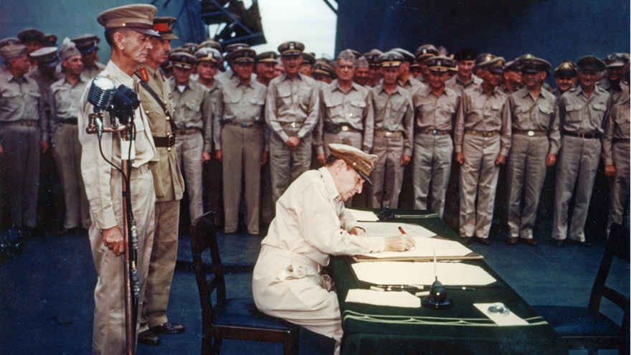
1I. What Does scra do?
TONS! – Interest rates, lease and service contract terminations, gym memberships, phones…
We are going to focus on:
Protections from default judgments
Stays of proceedings
Vacation of execution of judgments
Child custody protections
50 U.S.C. §§ 3901 - 4043

Slide 17
1I. Protection of servicemembers against default judgments
These protections apply to any civil action or proceeding, including any child custody proceeding, in which the defendant does not make an appearance.
Before a default judgment the Plaintiff must file an affidavit stating whether the defendant is in the military service or if they are unable to determine the defendant’s military status.
If it appears that the defendant is in the military service, the court may not enter a judgment until the court appoints an attorney to represent the defendant. If the attorney can not locate the servicemember their actions will not otherwise bind the servicemember.
If the defendant’s military status can not be established the plaintiff must file a bond approved by the court to indemnify the servicemember from any loss or damage incurred by setting the judgment aside.
50 U.S.C. § 3931
Notes:
Knowledge of and compliance with this right is important. It impacts the ability to attempt to enforce child support through, e.g., DFAS. See below.

Slide 18
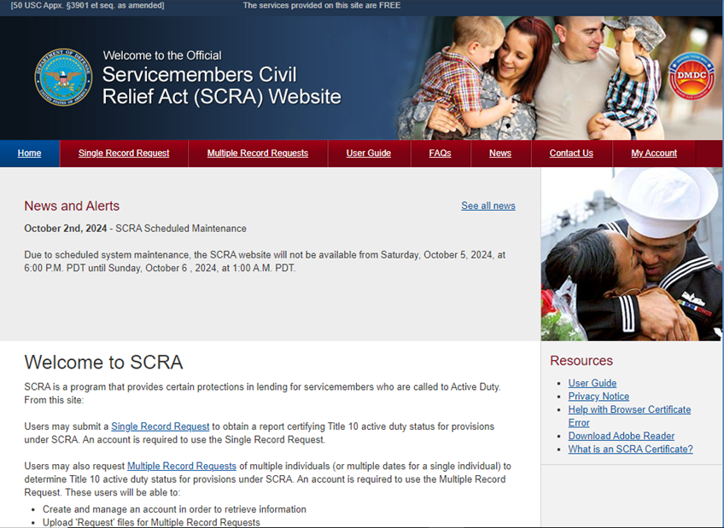
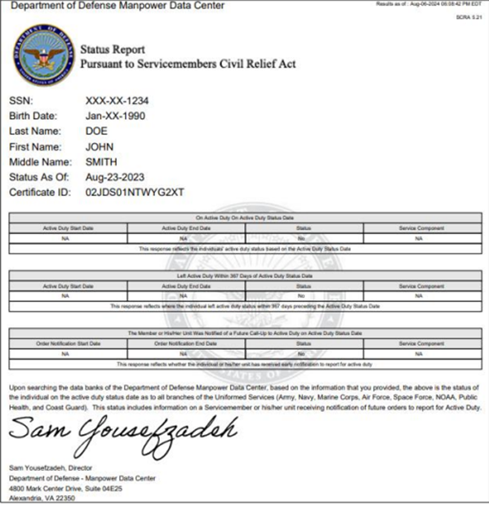
1I. How do I know if my defendant is a servicemember?
Check: https://scra.dmdc.osd.mil/scra/#/home
Create an account
Choose “Request a Single Record”
Search by SSN or last name and date of birth
The system will then generate a report on the member’s military status
Notes:
Note: This site may not “play well” with MS Edge in its current form.

Slide 19
1I. Stays of proceedings
If the Court determines that the defendant is a military member they shall grant a stay of proceedings for a minimum of 90 days under this section upon application of counsel, or on the court’s own motion, if the court determines:
There may be a defense to the action and a defense cannot be presented without the presence of the defendant; or
After due diligence, counsel has been unable to contact the defendant or otherwise determine if a meritorious defense exists.
50 U.S.C. § 3931
Additional: See In re Marriage of Bradley, 282 Kan 1, 137 P.3d 130, 2006 Kan. LEXIS 478. It is a 2006 Kansas case where a service member did not provide evidence that 1) that they were on military duty which prevented their appearance and, 2) a communication from their commanding officer that leave was not authorized. The Supreme Court of Kansas denied the stay and upheld a custody order against the servicemember.
Notes:
In re Marriage of Bradley

Slide 20
1I. A stay does not guarantee servicemembers a favorable outcome
Ms. Harrison and Mr. Lyman divorced in 2005, and Mr. Lyman was ordered to pay child support for the couple’s 4 children. Mr. Lyman deployed with the Alaska National Guard in 2006. Prior to his departure Ms. Harrison sought to modify their custody arrangement because she would have full-time custody of the children in his absence. The court did not hear Ms. Harrison’s case because Mr. Lyman requested a stay pursuant to SCRA. Mr. Lyman returned in 2007, but the matter was not heard until early 2009. At that time, Ms. Harrison’s petition was granted retroactively to the date it was filed, generating a debt of approximately $28,000 owed by Mr. Lyman. In 2010, Ms. Harrison requested a judgment against Mr. Harrison for the arrearage with interest. The Alaska Supreme Court held that, due to the State’s mandatory language regarding delinquent child support obligations, it was required to enter the judgement against Mr. Harrison.
Harrison v Lyman 2012 Alas. LEXIS 108, 2012 WL 3055070

Slide 21
1I. Vacating or setting aside of default judgments
If a default judgment is entered in an action covered by this section against a servicemember during the servicemember’s period of military service (or within 60 days after termination of or release from such military service), the court entering the judgment shall, upon application by or on behalf of the servicemember, reopen the judgment for the purpose of allowing the servicemember to defend the action if it appears that—
(A) the servicemember was materially affected by reason of that military service in making a defense to the action; and
(B) the servicemember has a meritorious or legal defense to the action or some part of it.
An application to vacate or set aside must be filed not later than 90 days after the date of the servicemember’s termination of or release from military service.
50 U.S.C. §§ 3931-3935

Slide 22
1I. Child custody protections
If a court renders a temporary order for custodial responsibility for a child based solely on a deployment or anticipated deployment of a parent who is a servicemember, the court shall require that the temporary order shall expire not later than the period justified by the deployment of the servicemember.
If a motion or a petition is filed seeking a permanent order to modify the custody of the child of a servicemember, no court may consider the absence of the servicemember by reason of deployment, or the possibility of deployment, as the sole factor in determining the best interest of the child.
50 U.S.C. § 3938

Slide 23
1I. WHAT is a deployment?
In this section, the term “deployment” means the movement or mobilization of a servicemember to a location for a period of longer than 60 days and not longer than 540 days pursuant to temporary or permanent official orders—
(1) that are designated as unaccompanied;
(2) for which dependent travel is not authorized; or
(3) that otherwise do not permit the movement of family members to that location.
50 U.S.C. § 3938

Slide 24
I1I. Child support obligations for service members
Child Support Obligations of Servicemembers
Challenges and Solutions for Serving Military Personnel
Role of Command Officer
Locating Military Personnel
Notes:
Child Support Obligations of Service Members
Branch Requirements:
Air Force: AFI 36-2906, Personal Financial Responsibility
Army: AR 608-99, Family Support Child Custody and Parentage
Marine Corps: Marine Corps Order (MCO) P5800.16A, Marine Corps Manual for Legal Administration, Chapter 15, Section 15001.
Navy: MILPERSMAN 1754-030, Support of Family Members
Coast Guard: Commandant Instruction M1000.6A, Chapter 8.M.
Space Force: [Air Force Instruction AFI 36-2906, Personal Financial Responsibility]
Challenges and Solutions for Serving Military Personnel
Serving deployed personnel outside of local jurisdiction.
Contacting the commanding officer or JAG office for service.
Acceptance of service from private process servers.
Serving personnel living on base versus private residences.
Handling service in classified/unclassified deployments.
Differences in service in combat zones vs. non-combat zones.
Role of Commanding Officers
Assisting with service on active-duty personnel.
Procedures for contacting a commanding officer for service purposes.
Locating Military Personnel
Finding the location where a respondent is stationed.
Determining the home state for jurisdiction purposes.

Slide 25
iiI. Military Authority Requires Servicemembers to support their dependents
Service Specific Requirements and Regulations:
Air Force and Space Force: AFI 36-2906, Personal Financial Responsibility
Army: AR 608-99, Family Support Child Custody and Parentage
Marine Corps: Marine Corps Order (MCO) P5800.16A, Marine Corps Manual for Legal Administration, Chapter 15, Section 15001.
Navy: MILPERSMAN 1754-030, Support of Family Members
Coast Guard: Commandant Instruction M1000.6A, Chapter 8.M.
Notes:
Part 581, “Processing Garnishment Orders for Child Support and/or Alimony” shrinks “Goliath” down to the size of “David” in a certain sense. It provides that money the U.S. owes individuals for employment shall be subject (1) to legal process for the enforcement of an obligor’s legal obligations to provide child support, alimony, or both, resulting from an action brought by an individual oblgiee; and (2) withholding in accordance with State law [ ] as if the United States were a private person.
2. Service of Process/Jurisdiction
Serving deployed personnel outside of local jurisdiction.
Appendix A of Part 581 provides a list of agents designated to accept legal process for the Executive Branch of the United States to establishment garnishment.

Slide 26
iiI. Military Authority Requires Servicemembers to support their dependents
These requirements are almost always lower than child support requirement established by state law. Often the minimum required amount will be tied to housing allowances or military pay rates.
HOWEVER
Servicemembers can face military discipline for failing to provide financial support to persons they are claiming as dependents.
ALSO
Servicemembers can face military discipline for failing to pay lawful debts or comply with civilian court orders.

Slide 27
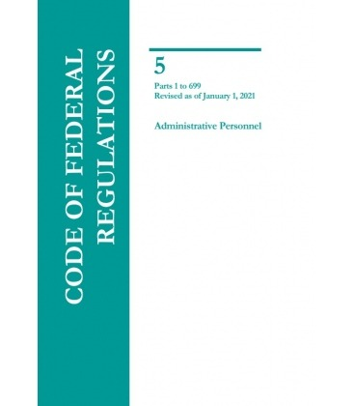
iiI. Service of process/jurisdiction
Challenges and Solutions for Serving Military Personnel
Start with 5 C.F.R. 581 Appendix A
Notes:
Part 581, “Processing Garnishment Orders for Child Support and/or Alimony” shrinks “Goliath” down to the size of “David” in a certain sense. It provides that money the U.S. owes individuals for employment shall be subject (1) to legal process for the enforcement of an obligor’s legal obligations to provide child support, alimony, or both, resulting from an action brought by an individual oblgiee; and (2) withholding in accordance with State law [ ] as if the United States were a private person.
2. Service of Process/Jurisdiction
Serving deployed personnel outside of local jurisdiction.
Appendix A of Part 581 provides a list of agents designated to accept legal process for the Executive Branch of the United States to establishment garnishment.

Slide 28
iiI. Service of process/jurisdiction
APPENDIX A
Department of Defense
Unless specifically listed below, all military members (active, retired, reserve, and national guard), and all civilian employees of the Department of Defense:
Defense Finance & Accounting Service
Office of General Counsel
Attn: Garnishment Law Directorate
P.O. Box 998002
Cleveland, OH 44199–8002
Fax: 216–367–3675
Toll-Free Fax: 877–622–5930
Phone: 888–332–7411
Notes:
Here you can see the part of that list that interests us right now: the Department of Defense. With a few rare exceptions, service of a legal process for garnishment is going to be upon the Defense Finance and Accounting Service’s of DFAS’ Office of General Counsel, to the attention of the “Garnishment Law Directorate.”

Slide 29
iiI. Service of process/jurisdiction
APPENDIX B
APPENDIX B TO PART 581—LIST OF AGENTS DESIGNATED TO FACILITATE THE SERVICE OF LEGAL PROCESS ON FEDERAL EMPLOYEES (The agents designated to accept legal process for the garnishment of the remuneration for employment due from the United States are listed in appendix A to part 581. Appendix B to part 581 lists the agents designated to assist in the service of legal process in civil actions pursuant to orders of State courts to establish paternity and to establish or to enforce support obligations by making Federal employees and members of the Uniformed Services available for service of process, regardless of the location of the employee’s workplace or of the member’s duty station. Agents are listed in appendix B only for those executive agencies where the designations differ from those found in appendix A to part 581.)

Slide 30
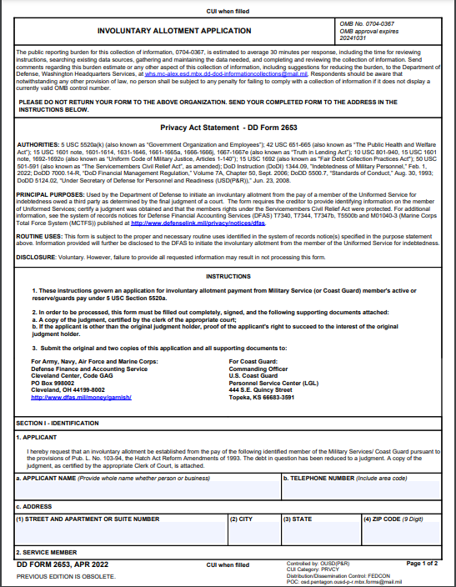
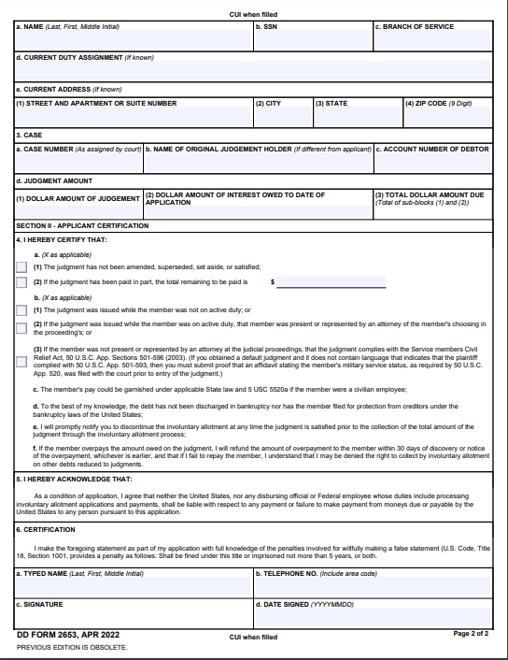
iiI. Involuntary Allotment Application
Defense Finance and Accounting Service (DFAS)
https://www.dfas.mil/garnishment/milcommdebt/debtcollect/
DD Form 2653 Involuntary Allotment Application
https://www.esd.whs.mil/Portals/54/Documents/DD/forms/dd/dd2653.pdf
Notes:
To generate an involuntary allotment (quasi garnishment) you should submit a DD Form 2653 to DFAS

Slide 31
iiI. Involuntary Allotment Application
Federal law authorizes allotments from active duty military pay in order to satisfy child support and alimony obligations. Alimony alone does not qualify under this law. These statutory allotments may only be paid from active duty pay.
Unless state law specifies a lesser amount, federal law provides a limit of 50 percent of the member’s aggregate disposable earnings for any workweek if the member is currently supporting a second family (spouse or child) and 60 percent if the member is not supporting a second family. The percentage may be increased by 5 percent if the arrearage is 12 weeks or more.
These procedures are governed by the DoD Financial Management Regulation, DoD 7000.14-R, Chapter 41 Garnishments and other Involuntary Allotments
Notes:
To generate an involuntary allotment (quasi garnishment) you should submit a DD Form 2653 to DFAS

Slide 32
1v. Military notice and service of process issues
Verification of Military Service
Providing Notice of Court Proceedings

Slide 33
1v. Locating Military Members
Start with SCRA website: https://scra.dmdc.osd.mil/scra/#/home
After you have confirmed status try the worldwide locator for the specific military service.
AIR FORCE (AND SPACE FORCE) : https://www.afpc.af.mil/Support/Worldwide-Locator/
MARINES:
Headquarters U.S. Marine Corps
Personnel Management Support Branch (MMSB-17)
2008 Elliot Road
Quantico, VA 22134-5030
NAVY:
Navy World Wide Locator
BUPERS-07 Customer Service Center
5720 Integrity Drive
Millington, TN 38055-3120
Notes:
One main and initial topic in this presentation concerns service of process and jurisdiction. In discussing this topic, we will talk about some basics regarding the challenges and solutions for serving military personnel, the role of the command officer, and locating military personnel.
The task of service of process of a child support enforcement order can be daunting when one is talking about the United States as an employer. This challenge only appears greater one the salaried individual is a member of the United States Armed Forces.
However, a key to navigating through this “David & Golliath” type scenario is found in the federal code of regulations, in 5 C.F.R. Part 581.

Slide 34
1v. Locating military members
The Army and the Coast Guard have discontinued operation of their worldwide locators. These addresses are dated but may be a good place to start as you look for a referral within the institutions.
Even if the services decline to provide locations for military members, they may be willing to provide them with documentation regarding the suit so they could voluntarily accept jurisdiction.
ARMY:
Commander U.S. Army Enlisted Records & Evaluation Center
ATTN: Locator
8899 East 56th Street
Fort Benjamin Harrison, IN 46249-5301
COAST GUARD:
Commandant, US Coast Guard
2100 2nd Street SW
Washington DC 20593-0001

Slide 35
1v. Service on military members
Work with local unit commanders or legal office/judge advocate general (JAGs)
Often, military authorities will not directly facilitate service on a military member, but they may counsel the member on the impact that a failure to support their dependents or pay their just debts may have on their military career.
The role of a first Sergeant or “shirt”.
Notes:
Article 134- dishonorable failure to pay debts

Slide 36
1v. Service on military members
Military members do not have any additional protections regarding service of process (SCRA does not discuss service)
BUT
Jurisdiction on military bases can sometimes be an issue (some bases have land that is exclusive federal jurisdiction which prevents state law authorities from operating there)
Jurisdiction in foreign countries is often problematic. If a servicemember does not voluntarily accept service of a state court process, the process must be served pursuant to the laws of the host nation. See 32 C.F.R. § 516.12(c)
Service in a combat zone is practically impossible

Slide 37
1v. Service on military members
Germany
In the case of active duty members stationed in the Federal Republic of Germany, all legal processes issued by German courts are to be served in the manner prescribed by German law to the appropriate liaison agency listed for such members.
Army, Navy and Marine Corps
Office of the Judge Advocate
HQ USAREUR
Postfach 42 02 24
65103 Wiesbaden
Air Force and Space Force
HQ USAFE/AFRICA/JA
Gegbaude 527
66877 Ramstein-Flugplatz
Germany

Slide 38
V. VA Benefits
Income Withholding Orders
Determining Income
Redirecting Dependency Allowance
Health Insurance Information
Discovering Additional Information

Slide 39
V. VA Benefits
Income Withholding Orders
Notes:
“A garnishment is a legal procedure, authorized by a court order, by which a creditor can collect what a debtor owes by reaching the debtor's property when the debtor does not possess the property.”
Federal law does not prevent the garnishment of military retired pay (MRP) when the Veteran receives DVA disability compensation. However, “Under Public Law 95-30, a Veteran’s disability compensation may be garnished in order to pay alimony or child support pursuant to a court order only if the Veteran receives disability compensation in lieu of an equal amount of MRP, in accordance with a total or partial MRP waiver. In these cases, under 5 CFR 581.103, finance activity and the Veterans Service Center (VSC)
withhold disability compensation, and
make a payment in compliance with the garnishment order for certain categories of payees.”

Slide 40
V. VA Benefits
Income Withholding Orders
Notes:
Whether a request for apportionment is made, whether an apportionment is granted, and whether a garnishment of disability benefits is sought (or obtained), the issue of whether money from disability compensation should be paid in part as child support is not necessarily over if we recall the Rose case.
In Rose v. Rose, 481 U.S. 619 (1987), Held: A state court has jurisdiction to hold a disabled veteran in contempt for failing to pay child support, even if the veteran's only means of satisfying this obligation is to utilize veterans' benefits received as compensation for a service-connected disability. The Tennessee statute, as construed by the state courts to authorize an award of disability benefits as child support, is not pre-empted under the Supremacy Clause of Article VI since it does not conflict with federal law. Pp. 2033–2039. Waivers of sovereign immunity are strictly construed, and we find no indication in the statute that a state-court order of contempt issued against an individual is precluded where the individual's income happens to be composed of veterans' disability benefits. In this context, the Veterans' Administration is not made a party to the action, and the state court issues no order directing the Administrator to pay benefits to anyone other than the veteran. Thus, while it may be true that these funds are exempt from garnishment or attachment while in the hands of the Administrator, we are not persuaded that once these funds are delivered to the veteran a state court cannot require that veteran to use them to satisfy an order of child support.

Slide 41
V. VA Benefits
Determining Income

Slide 42
V. VA Benefits
Determining Income
Notes:
location.

Slide 43
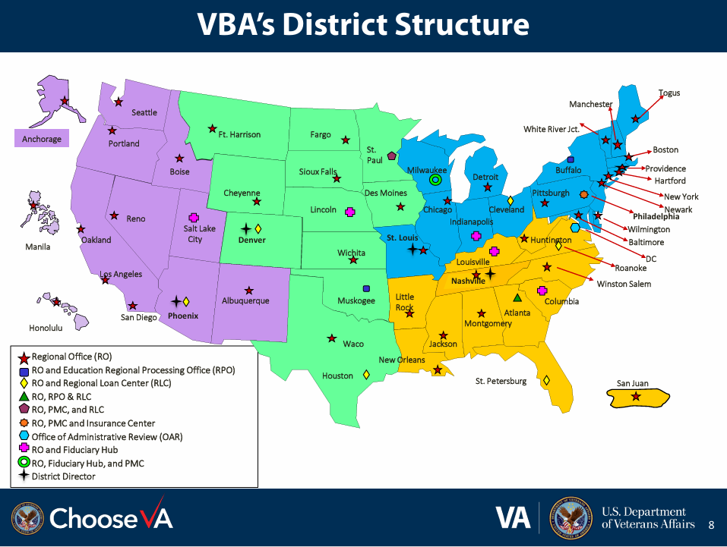
V. VA Benefits
Determining Income

Slide 44
V. VA Benefits
Determining Income

Slide 45
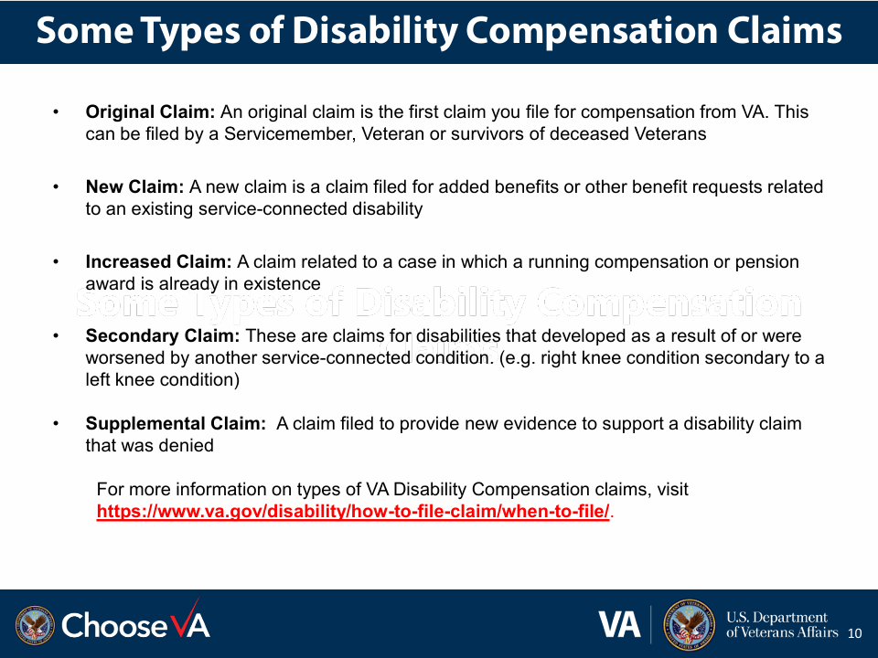
V. VA Benefits
Determining Income
Notes:
the VA uses.

Slide 46
V. VA Benefits
Determining Income
Dependent status | 30% disability rating (in U.S. $) | 40% disability rating (in U.S. $) | 50% disability rating (in U.S. $) | 60% disability rating (in U.S. $)
Veteran alone (no dependents) | 524.31 | 755.28 | 1,075.16 | 1,361.88

Slide 47
v. VA Benefits
Determining Income
Dependent status | 70% disability rating (in U.S. $) | 80% disability rating (in U.S. $) | 90% disability rating (in U.S. $) | 100% disability rating (in U.S. $)
Veteran alone (no dependents) | 1,716.28 | 1,995.01 | 2,241.91 | 3,737.85

Slide 48
V. VA Benefits
Determining Income
Basic monthly rates for 30% to 60% disability rating
Dependent status | 30% disability rating (in U.S. $) | 40% disability rating (in U.S. $) | 50% disability rating (in U.S. $) | 60% disability rating (in U.S. $)
Veteran with 1 child only (no spouse or parents) | 565.31 | 810.28 | 1,144.16 | 1,444.88
With 1 child and spouse (no parents) | 632.31 | 899.28 | 1,255.16 | 1,577.88
With 1 child, spouse, and 1 parent | 682.31 | 965.28 | 1,338.16 | 1,677.88
With 1 child, spouse, and 2 parents | 732.31 | 1,031.28 | 1,421.16 | 1,777.88
With 1 child and 1 parent (no spouse) | 615.31 | 876.28 | 1,227.16 | 1,544.88
With 1 child and 2 parents (no spouse) | 665.31 | 942.28 | 1,310.16 | 1,644.88

Slide 49
V. VA Benefits
Determining Income
Added amounts for 30% to 60% disability rating
Dependent status | 30% disability rating (in U.S. $) | 40% disability rating (in U.S. $) | 50% disability rating (in U.S. $) | 60% disability rating (in U.S. $)
Each additional child under age 18 | 31.00 | 41.00 | 51.00 | 62.00
Each additional child over age 18 in a qualifying school program | 100.00 | 133.00 | 167.00 | 200.00
Spouse receving Aid and Attendance | 57.00 | 76.00 | 95.00 | 114.00

Slide 50
iV. VA Benefits
Determining Income
Basic monthly rates for 70% to 100% disability rating
Dependent status | 70% disability rating (in U.S. $) | 80% disability rating (in U.S. $) | 90% disability rating (in U.S. $) | 100% disability rating (in U.S. $)
Veteran with child only (no spouse or parents) | 1,813.28 | 2,106.01 | 2,366.91 | 3,877.22
With 1 child and spouse (no parents) | 1,968.28 | 2,283.01 | 2,565.91 | 4,098.87
With 1 child, spouse and 1 parent | 2,085.28 | 2,416.01 | 2,715.91 | 4,266.13
With 1 child, spouse and 2 parents | 2,202.28 | 2,549.01 | 2,865.91 | 4,433.39
With 1 child and 1 parent | 1,930.28 | 2,239.01 | 2,516.91 | 4,044.48
With 1 child and 2 parents (no spouse) | 2,047.28 | 2,372.01 | 2,666.91 | 4,211.74

Slide 51
V. VA Benefits
Determining Income
Added amounts for 70% to 100% disability rating
Dependent status | 70% disability rating (in U.S. $) | 80% disability rating (in U.S. $) | 90% disability rating (in U.S. $) | 100% disability rating (in U.S. $)
Each additional child under age 18 | 72.00 | 82.00 | 93.00 | 103.55
Each additional child over age 18 in a qualifying school program | 234.00 | 267.00 | 301.00 | 334.49

Slide 52
V. VA Benefits
Determining Income
1 (800) 827-1000

Slide 53
V. VA Benefits
Redirecting Dependency Allowance

Slide 54
v. VA Benefits
Redirecting Dependency Allowance

Slide 55
V. VA Benefits
Health Insurance Information

Slide 56
V. VA Benefits
Discovery Additional Information

Slide 57
VI. Leave earnings statement
Understanding Military Paystubs
Obtaining Leave and Earnings Statements
Initiating Child Support Payments on Service Members

Slide 58
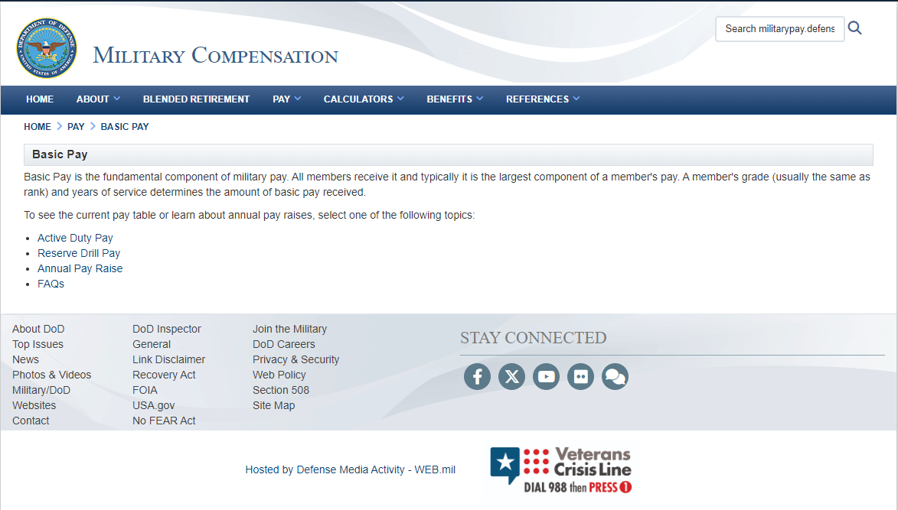
VI. Leave and earnings statement
Understanding Military Paystubs
Notes:
Basic Pay (defense.gov)

Slide 59
VI. Leave and earnings statement
Understanding Military Paystubs
https://militarypay.defense.gov/Pay/Basic-Pay/Active-Duty-Pay/
https://militarypay.defense.gov/Pay/Basic-Pay/Reserve-Drill-Pay/
Notes:
Basic Pay (defense.gov)
Military Compensation > Pay > Basic Pay > Active Duty Pay (defense.gov)

Slide 60
VI. Leave and earnings statement
Understanding Military Paystubs

Slide 61
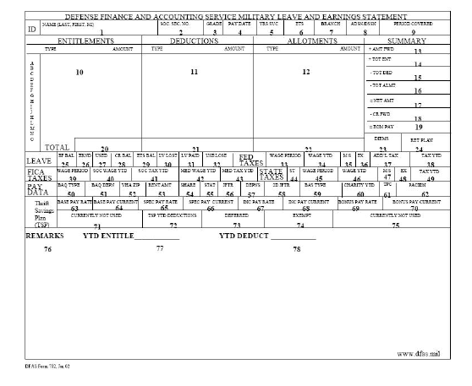
VI. Leave and earnings statement
Understanding Military Paystubs

Slide 62
VI. Leave and earnings statement
Obtaining Leave and Earnings Statements

Slide 63
VI. Leave and earnings statement
Initiating Child Support Payments on Service Members

Slide 64
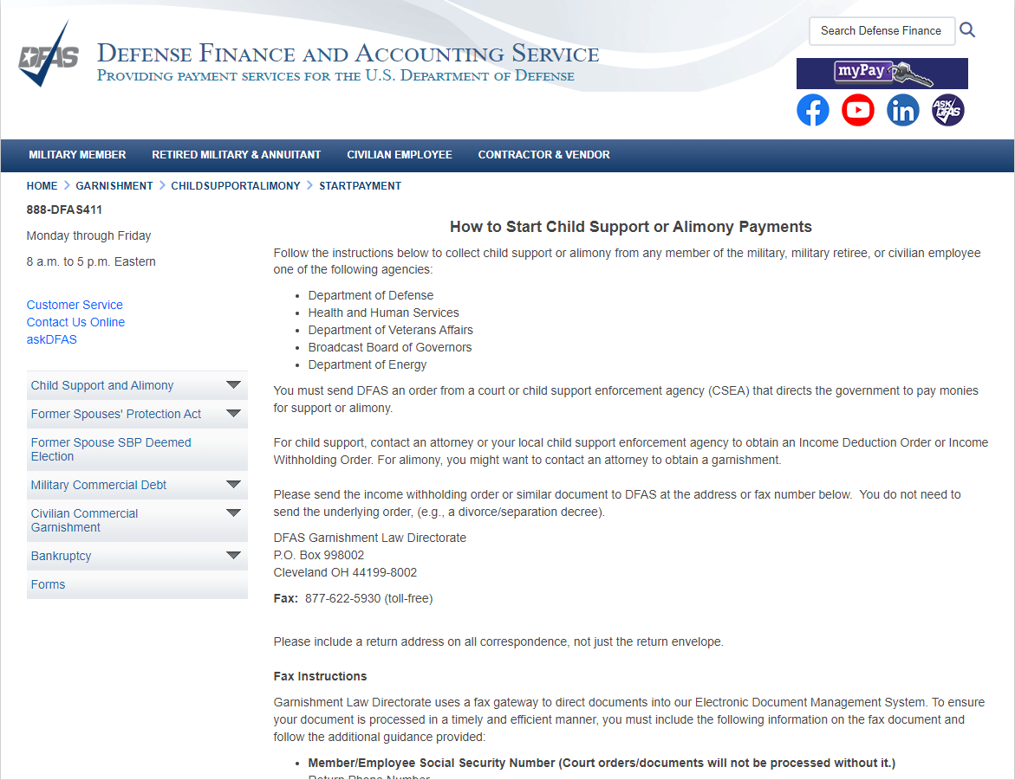
VI. Leave and earnings statement
Initiating Child Support Payments on Service Members
Notes:
Defense Finance and Accounting Service > Garnishment > childsupportalimony > startpayment (dfas.mil)
https://www.dfas.mil/Garnishment/childsupportalimony/startpayment/

Slide 65
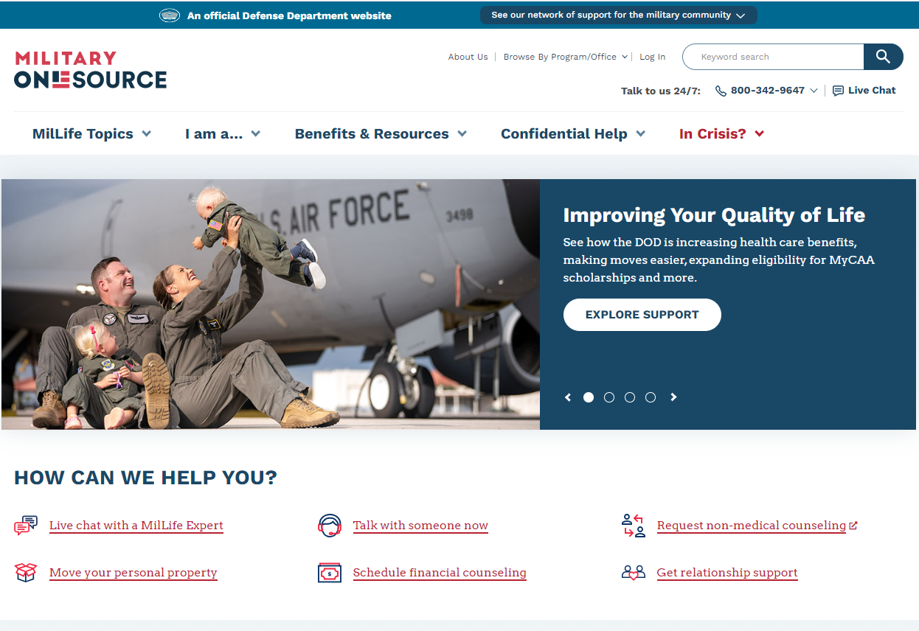
https://www.militaryonesource.mil/
Notes:
DoD endorsed platform of services available to eligible service members, veterans and family.

Slide 66
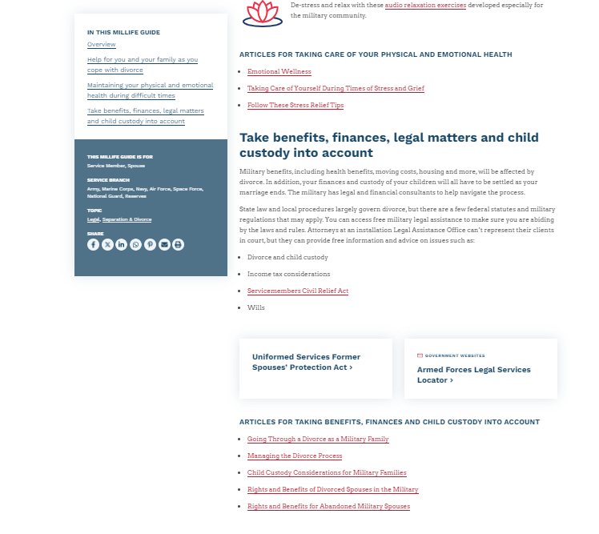
https://www.militaryonesource.mil/resources/millife-guides/navigating-divorce/#consider-benefits-finances-legal-matters-child-custody
Notes:
https://www.militaryonesource.mil/resources/millife-guides/navigating-divorce/#consider-benefits-finances-legal-matters-child-custody
Note that within Military OneSource, there is a page entitled “Navigating Divorce.” The page includes some references to information that might be useful. In particular, it discussing the potential availability of military legal offices (“Legal Assistance”).

Slide 67
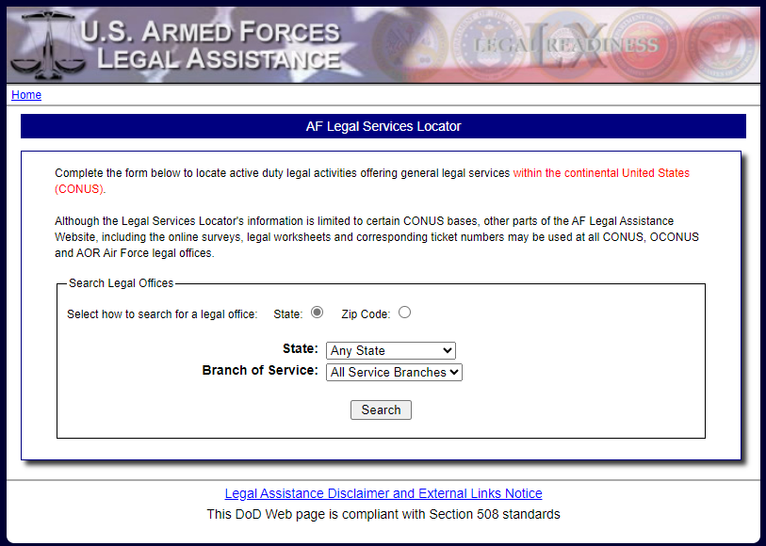
https://legalassistance.law.af.mil/
Notes:
U.S. Armed Forces Legal Assistance’s (AF) Legal Services Locator.

Slide 68
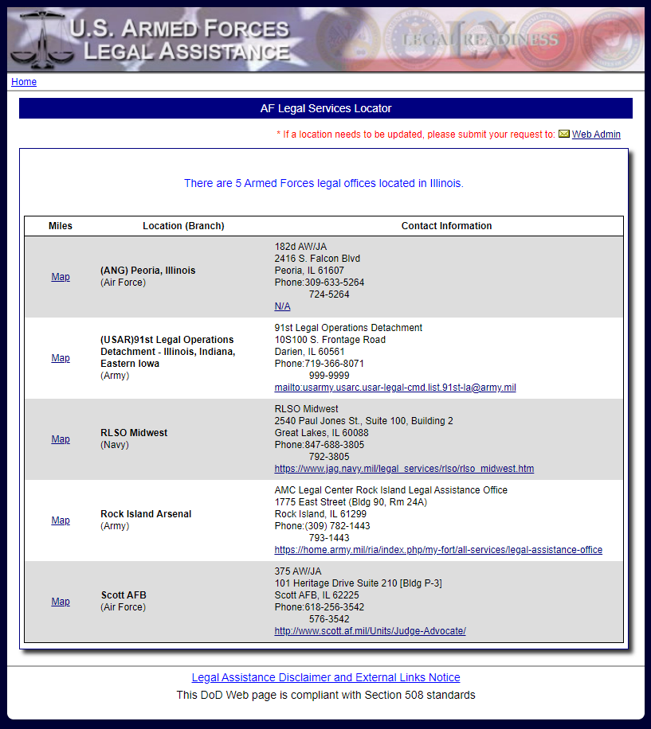
https://legalassistance.law.af.mil/
Notes:
U.S. Armed Forces Legal Assistance’s (AF) Legal Services Locator.

Slide 69
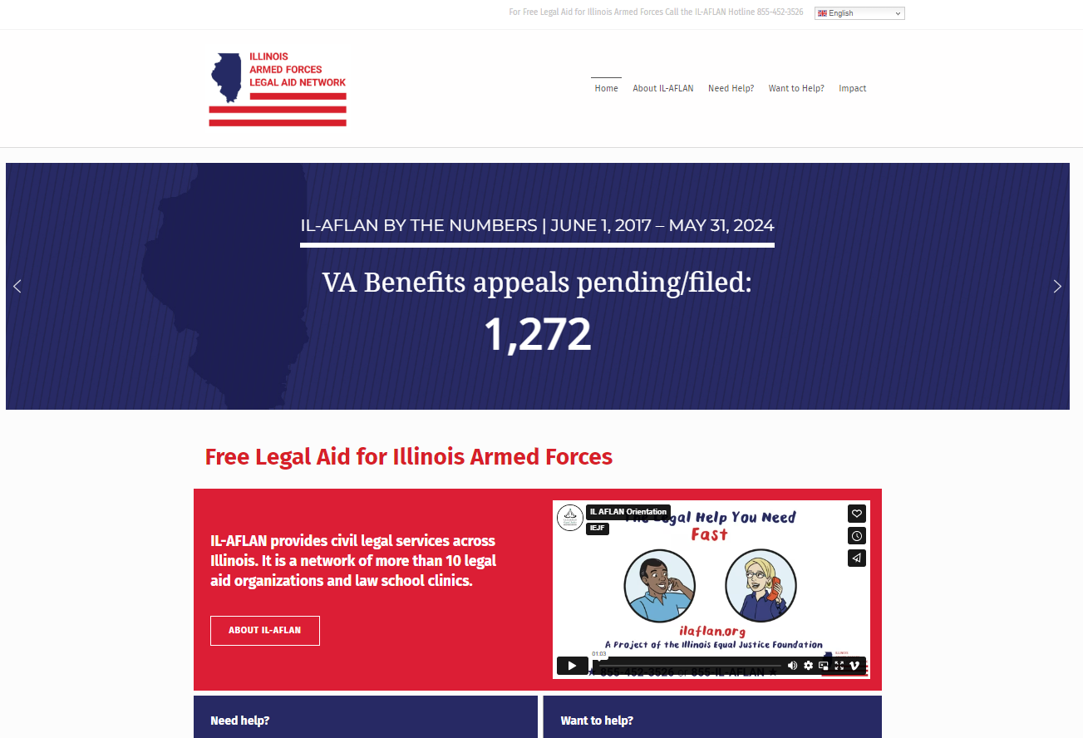
855-IL-AFLAN (855-452-3526)
IL-AFLAN: Free Legal Aid for Illinois Armed Forces (ilaflan.org)
Notes:
https://ilaflan.org
Call 855-IL-AFLAN (855-452-3526)
IL-AFLAN provides civil legal services across Illinois. It is a network of more than 10 legal aid organizations and law school clinics.
Its key features and eligibility requirements include:
A statewide hotline that provides legal information, advice, brief services (including the preparation and review of legal documents), and referrals to veterans, service members, national guard, reservists, and their spouses and dependents. The hotline acts as the hub of the network.
Uniform eligibility guidelines: 80% of Chicago Area Median Income (applies statewide), no dishonorable discharges, spouse or dependent can’t use services in legal action adverse to veteran/service member.
CALL 855-IL-AFLAN (855-452-3526) TO TALK TO AN ATTORNEY if you are a veteran, service member, national guard, reservist, or spouse or dependent. Call to talk about discharge upgrades, benefits appeals, and civil legal problems like Family, Housing, and Consumer issues.
Please call when you have time to talk with an attorney and any relevant documents in front of you. On average, you will be speaking to an attorney in about five minutes. If wait times are unusually long you will be prompted to arrange a call-back after waiting for 10 minutes. You will never wait more than 10 minutes.

Slide 70
Questions?
Grant T. Swinger
Staff Attorney
U.S. Department of Veterans Affairs
Office of General Counsel
Office of Chief Counsel-Midwest District
Work Cell: (708) 901-4818
Email: grant.swinger@va.gov
William H. Phillips
Senior Assistant Attorney General/ ISERRA Advocate
Military and Veterans Rights Bureau
Illinois Attorney General’s Office
Work Cell: (217) 299-4648
Email: william.phillips@ilag.gov

