Slide 1
Fatherhood Current and Future Efforts
Meshia Henderson, Dr. Kirk Harris, Kati Johnson

Slide 2
Thought Experiment

Slide 3
The Child Support Quadrants
Ability to Pay
Desire to Pay
No Ability to Pay
Desire to Pay
Ability to Pay
No Desire to Pay
No Ability to Pay
No Desire to Pay

Slide 4
Meshia Henderson
Maximus

Slide 5
The negative reputation of child support services has always preceded itself from the perspective of both noncustodial and custodial parents. For decades, collections and enforcement were the driving forces of our work — and we enforced with no support for the noncustodial parent. Understanding that barriers to employment and self-sufficiency exist for both parents, child support projects across the nation are realizing that we have an obligation to navigate our customers to services that aid in self-sufficiency, and that in doing so, we can help revitalize the perception of child support. It takes time to change the views of a community of people, but we are doing it successfully. In this inspiring workshop, we’ll show you how.

Slide 6
FACTS
According to the
U.S. Census Bureau,
19.5 million children, more than 1 in 4,
live without a
father in the home.

Slide 7
The History of Child Support Enforcement: Payments over Presence
Social Security Act of 1974
Child Support Enforcement Amendments
The Family Support Act
PRWORA

Slide 10
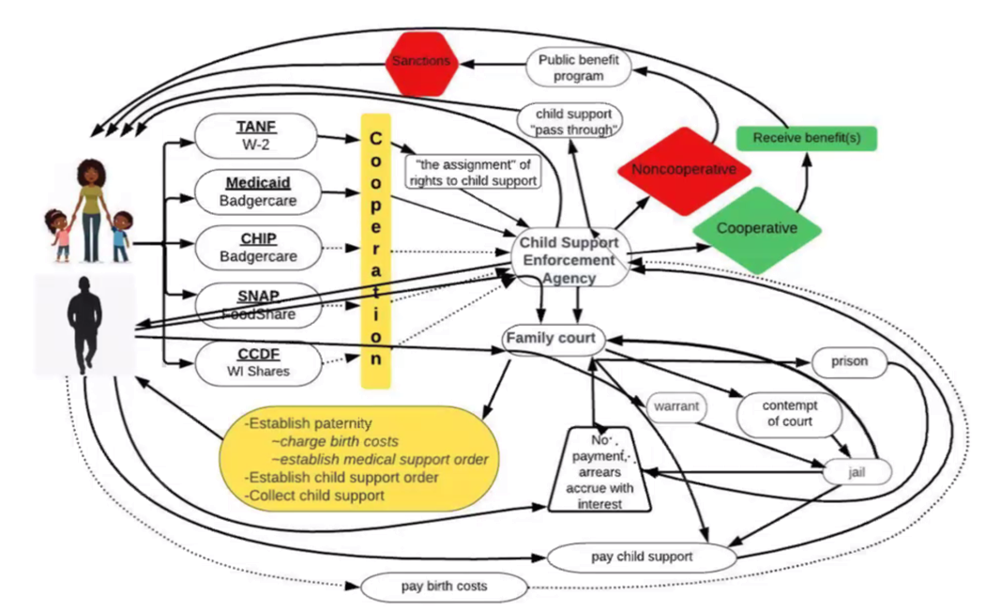

Slide 11
FACTS
Involved Dads improve their children’s overall emotional and social well-being.

Slide 12
Training Child Support Staff to Improve Service Delivery
Eliminating biases
Motivational Interviewing

Slide 13
Identifying and Eliminating Biases
Unconscious Bias: If You Have a Brain, You Have a Bias
Affinity Bias: The natural tendency to favor people that are like us.
Attribution Bias: The tendency to attribute achievements and failures to personal characteristics.
Halo Effect: The tendency to draw conclusions about someone based off of one single positive attribute.
Horn Effect: The tendency to draw conclusions about someone based off of one single negative attribute.
Confirmation Bias: The tendency to seek only information that confirms your existing biases while ignoring all conflicting information.
Perception Bias: The tendency to develop a bias based on characteristics such as age, race, ethnicity, and education level.

Slide 14
Motivational Interviewing:
An effective way of talking to people about change

Slide 15
Four Core Principles of Motivational Interviewing
Partnership
Acceptance
Compassion
Evocation

Slide 16
Four Core Principles of Motivational Interviewing
-Open-ended questions
-Affirmations
-Reflections
-Summaries

Slide 17
FACTS
Children living without a father in the home are 47% more likely to live in poverty.

Slide 18
FACTS
Men with absent fathers are more likely to become absent fathers themselves.
Women with absent fathers are more likely to have children with men who become absent fathers.

Slide 19
Fatherhood Programs:
Education and opportunity
Fatherhood Strengthening Training
Co-parenting

Slide 21
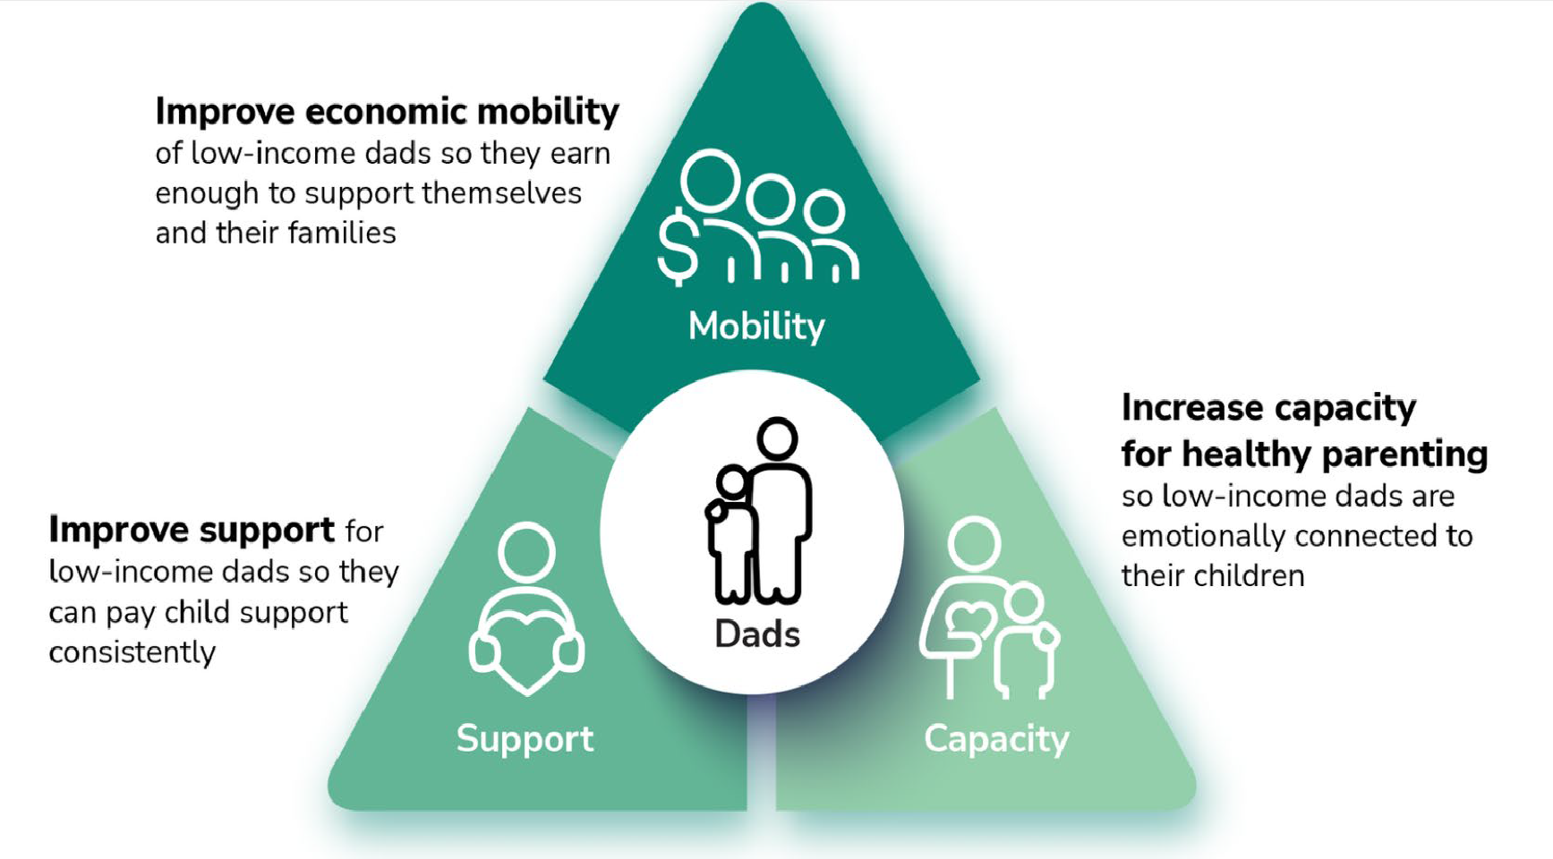

Slide 22
FACTS
Good co-parenting lowers parents' stress and improves children's growth.
When moms support dads’ involvement, moms and dads are closer co-parents.

Slide 23
FACTS
Children with imprisoned fathers are more likely to have depression.

Slide 24
Results
Payment assistance
Stronger families
Stronger communities

Slide 25
FACTS
Dads who build their parenting skills are more involved with their children.
Children with involved fathers have fewer behavioral and psychological problems.

Slide 26
Changing collection calls to payment assistance calls:
Over 14,000 income withholding orders
6% increase in collections
3,000 resource referrals
1,000 modifications
235 driver license reinstatements
245 warrants removed

Slide 27
Lessons Learned
Training is key
Culture eats strategy for lunch
You MUST have community partners to succeed
Track your results

Slide 28
Father Engagement Is Not Rocket Science: The Fundamentals
Dr. Kirk E. Harris
University of Wisconsin-Milwaukee
Parent and Community Technology (PACT) and Law Center

Slide 29
Father Engagement Fundamentals
Critical to acknowledge fathers as an important part of the family system
Involve fathers in the lives of their children from the earliest moment possible and share information with fathers about their child
Engage men in a discourse about healthy concepts of manhood and fatherhood
Encourage and underwrite father support groups

Slide 30
Father Engagement Fundamentals
Promote fathers as nurturers and caregivers, not just providers
Realize outreach to fathers is different than outreach to moms
Identify services to which fathers can be referred. But also, it is essential to see fathers as a resource and activate them as volunteers, fathers like to contribute not just receive services

Slide 31
Father Engagement Fundamentals
Engage in organizational assessment related to father engagement practice, including considering: welcoming environment; understanding the difference in mothering and fathering parenting styles; organizational executive leadership
Help transform organizational, community and general public narratives about fathers
Rigorously evaluate program activities related to father engagement

Slide 32
Family Resource Connections
Kati Johnson

Slide 34
Our Achievements
Fair and equitable child support payments by transitioning to an income shares model.
Interest reform, allowing the parent to decide whether the pursuit of interest on past due support is in the family’s best interests.
No credit reporting, eliminating additional difficulties for parents seeking better employment or securing more stable housing, and
Full family distribution of child support – pass through, no longer retaining any child support payments received as reimbursement for the assistance provided.

Slide 35
Employment Opportunities
Domestic Violence Support
Addiction Prevention
Network of Advocates
A Network of Resources to Meet the Needs of the Families We Serve

Slide 36
Virtual Career Workshops with HFS, IDES and CMS
Family Centered. Service Focused.
Transforming to better serve you!

Slide 37
Family Focus Workgroup
Elevating the voices, interests, ideas, and concerns of the families and individuals served by the CSS program to ensure that the services we offer meet their needs.

Slide 38
For more information visit Family Resource Connections (https://hfs.illinois.gov/childsupport/parents/family-resource-connections.html) Or email us at HFS.DCSSConnect@illinois.gov

Slide 39
QUESTIONS?
COMMENTS?

